Slide 1
VirtualBatteryFoam: A Multi-physics Numerical Solver to Simulate the Aluminium Electrolysis
Varchasvi Nandana, Roman Gutt, Hendrik Gesell, Alessandro Cubeddu, Roman Duessel, Uwe Janoske
27.02.2019
Chair of Fluid Mechanics
Bergische Universität Wuppertal
Notes:
Represent the chair of fluid mechanics of wuppertal, espacialy the Aluminium Electrolysis team, involved people (read names)

Slide 2
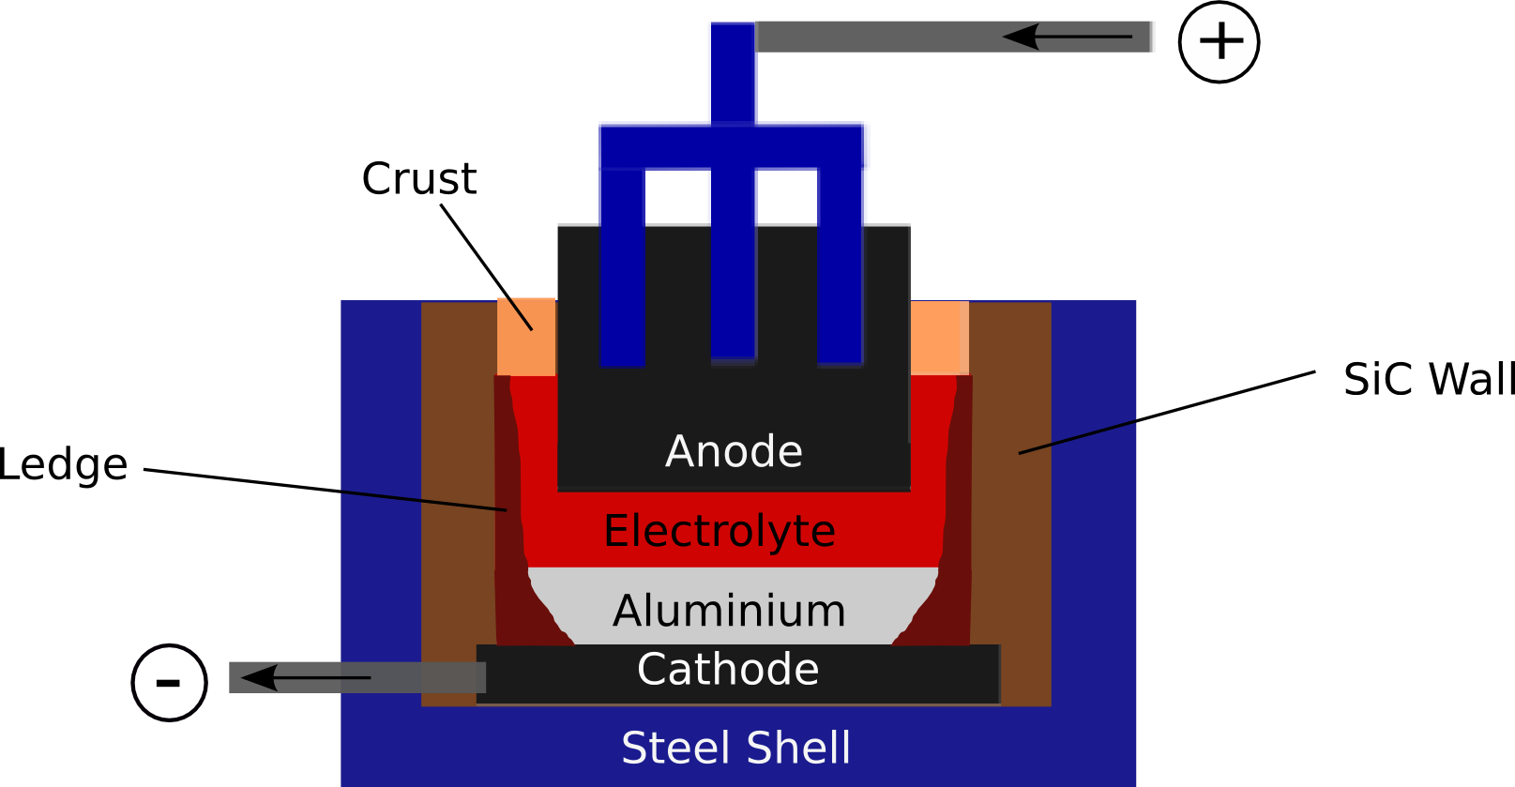
VirtualBatteryFoam: A multi-physics numerical solver to simulate aluminium electrolysis
Aluminium Electrolysis
Conventional industrial cells are designed for constant power
Shift towards renewable sources of energy demands
  Process flexibility
  Production efficiency
27.02.2019
Notes:
Current is supplied to the cell over the busbar system into the Steel rod -> fork -> carbon anode, surrounded by electrolyte (cryolite), ->aluminium -> cathode -> collectorbar -> next cell
Cryolite low conductivity -> Aluminium high conductivity -> Most of voltage drop inside electrolyte
Low conductivity cryolite -> Joule Heating -> Liquid Cryolite , Aluminum (660°C)
Ledge -> Solid cryolite at wall -> Protects the insulation
Frequently insert aluminum oxide -> reacts with anode -> CO2 + Aluminum is produced.
Right now conventional cell -> constant current
Goal -> Process flexibility -> stabelize power supply -> flexibility sometimes more important than efficiency

Slide 3
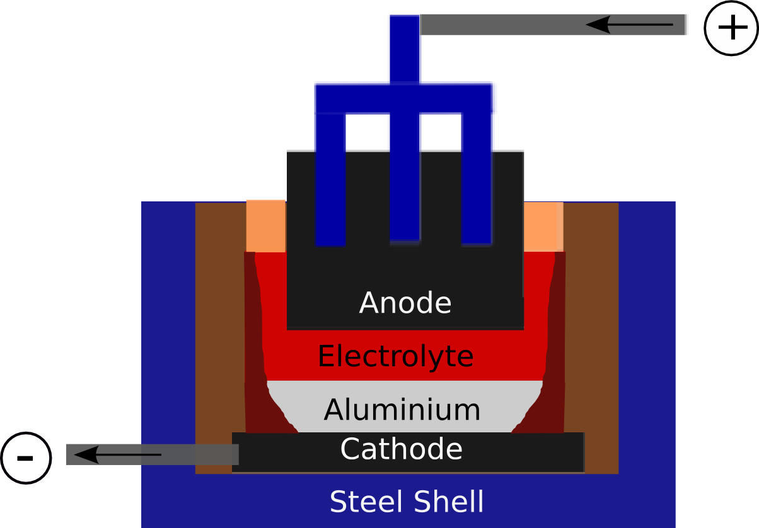
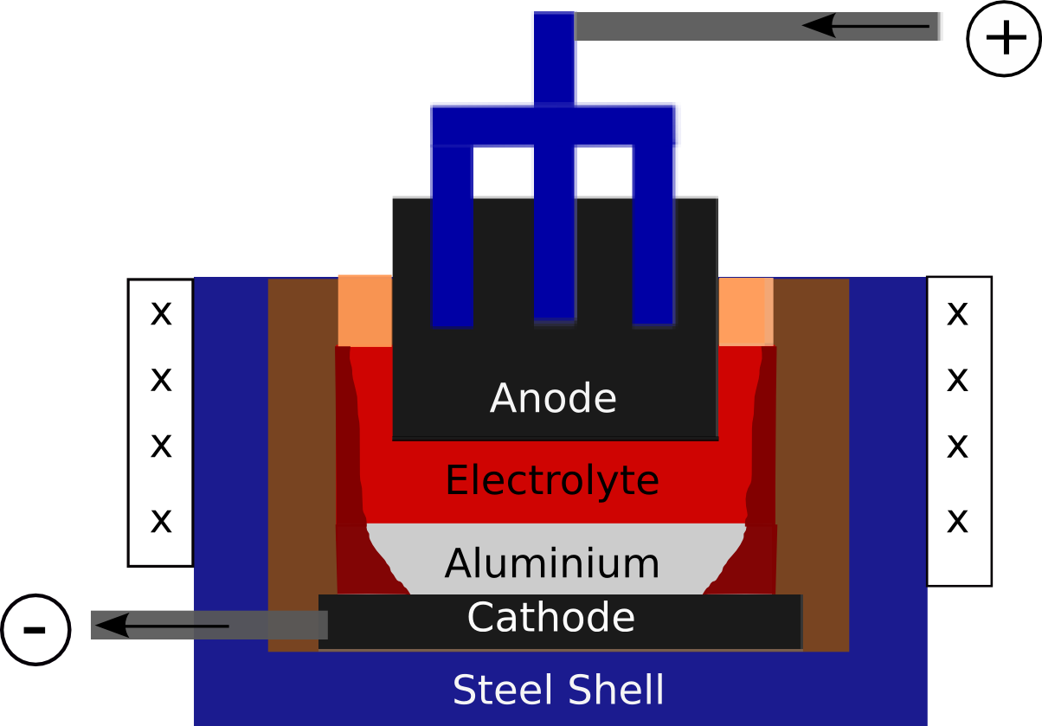
VirtualBatteryFoam: A multi-physics numerical solver to simulate aluminium electrolysis
Aluminium Electrolysis as virtual battery
Power variation in
Grid
Anode to cathode distance (ACD)
Shell heat exchanger
27.02.2019
Notes:
Problems involved from flexible current supply -> heat generated -> Increase Current -> Joule heating -> control -> ACD + SHE -> ledge thickness

Slide 4
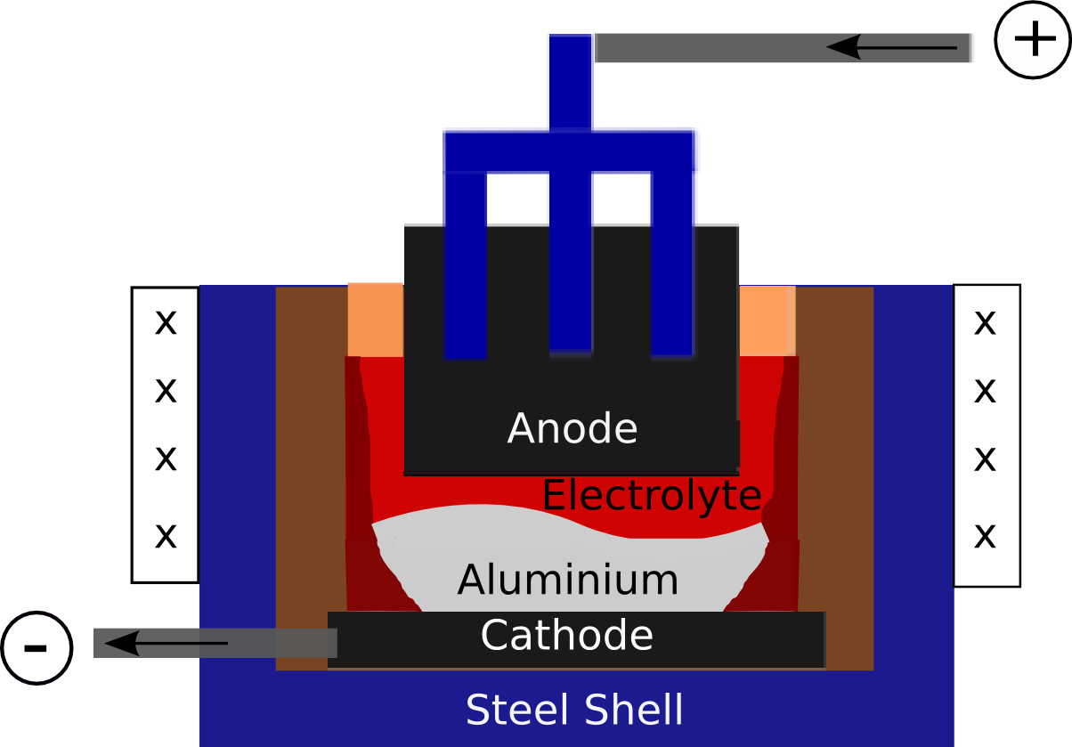
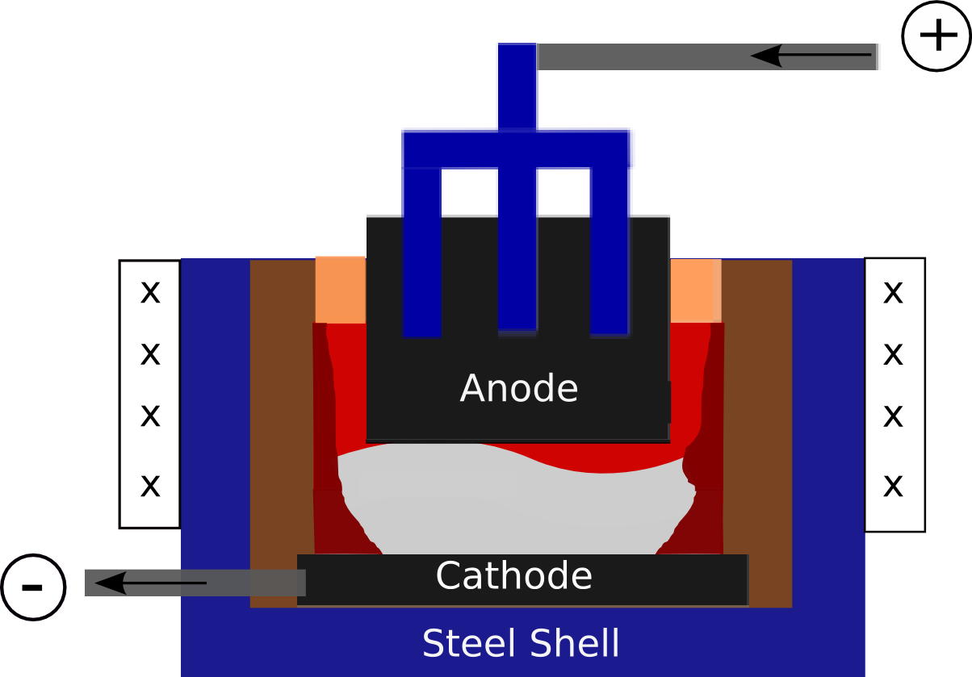
VirtualBatteryFoam: A multi-physics numerical solver to simulate aluminium electrolysis
Aluminium Electrolysis
Aluminium Electrolysis as virtual battery
Reducing cell voltage leads to magneto-hydrodynamic instabilities!!
27.02.2019
Notes:
High current -> Induced magnetic field ->High Lorentz -> Disturbs ->Aluminium contact with anode
Conclusion reducing voltage -> mhd instasbilities

Slide 5
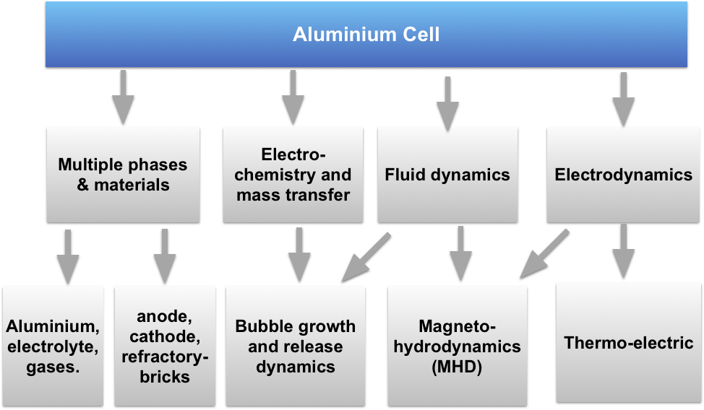
VirtualBatteryFoam: A multi-physics numerical solver to simulate aluminium electrolysis
Aluminium Electrolysis: A complex problem
27.02.2019
Notes:
Many physical phenomenas are involved

Slide 6
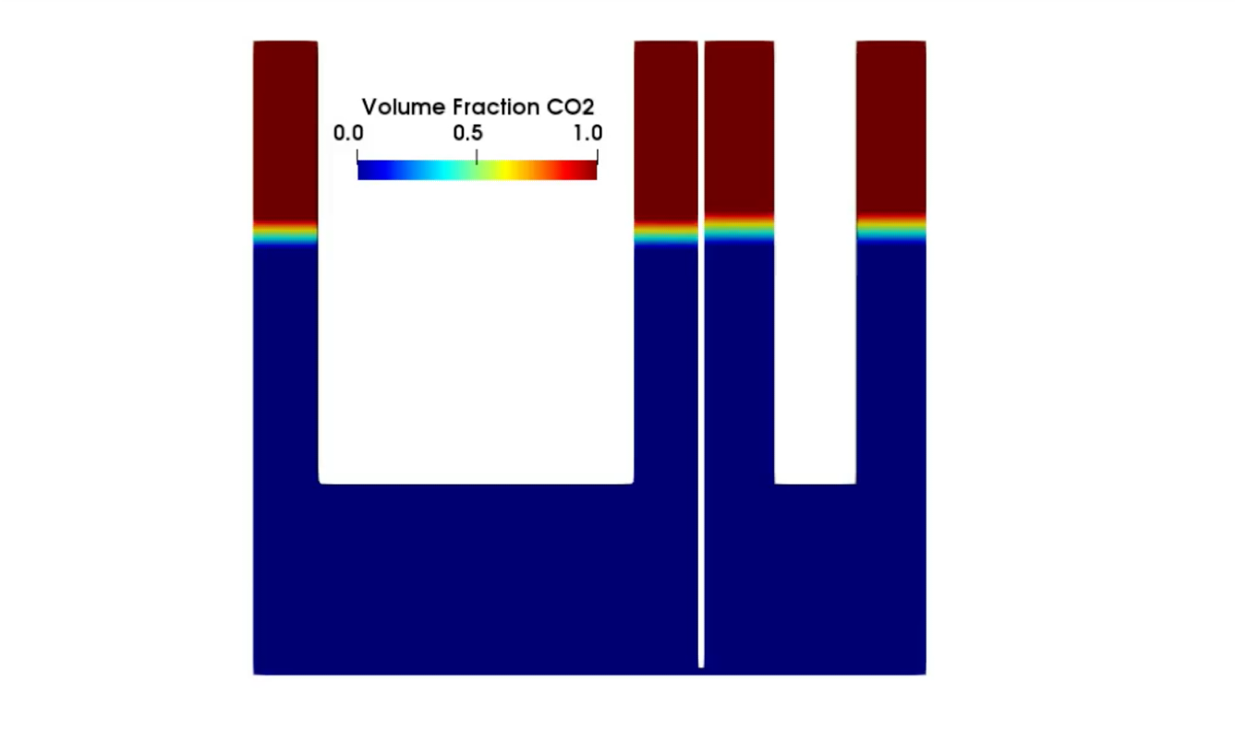
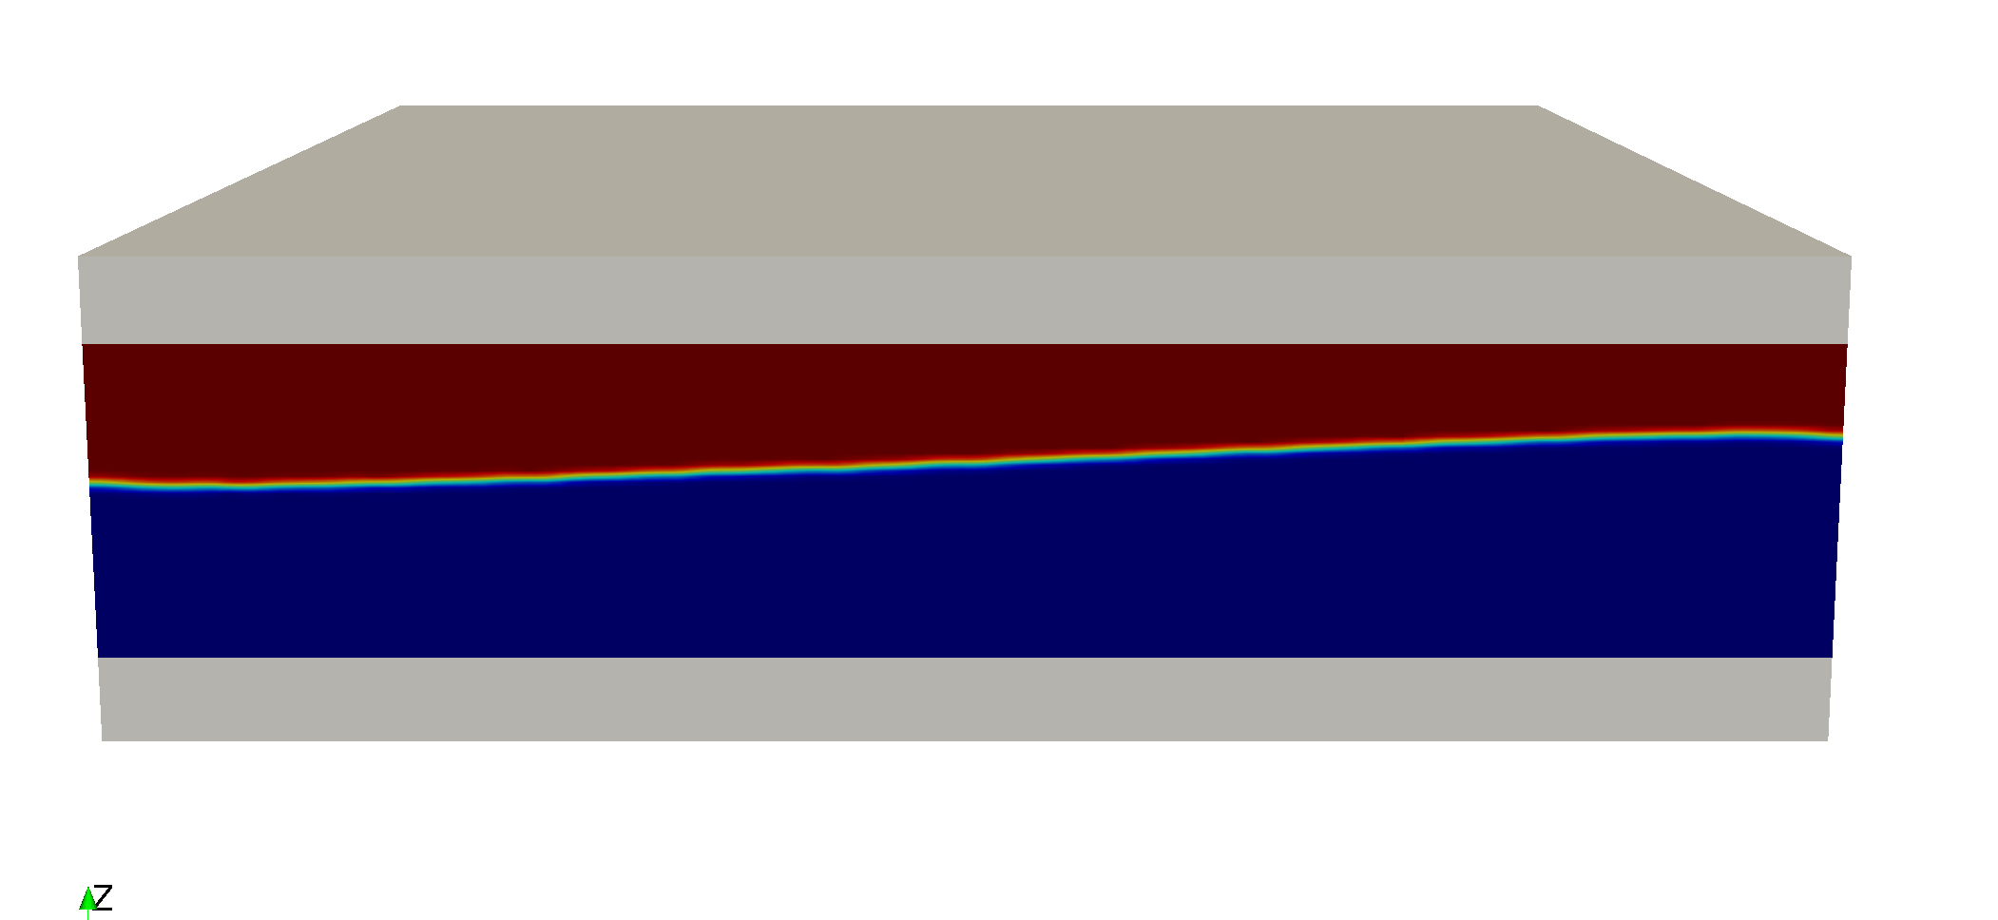
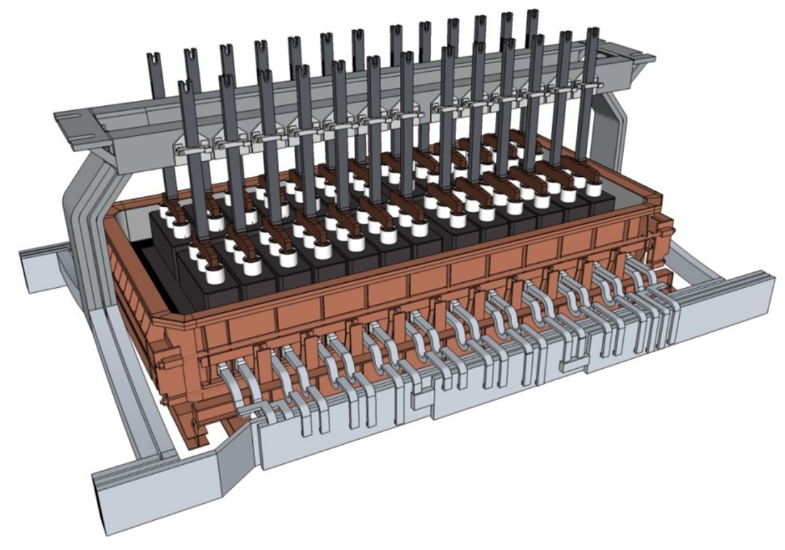
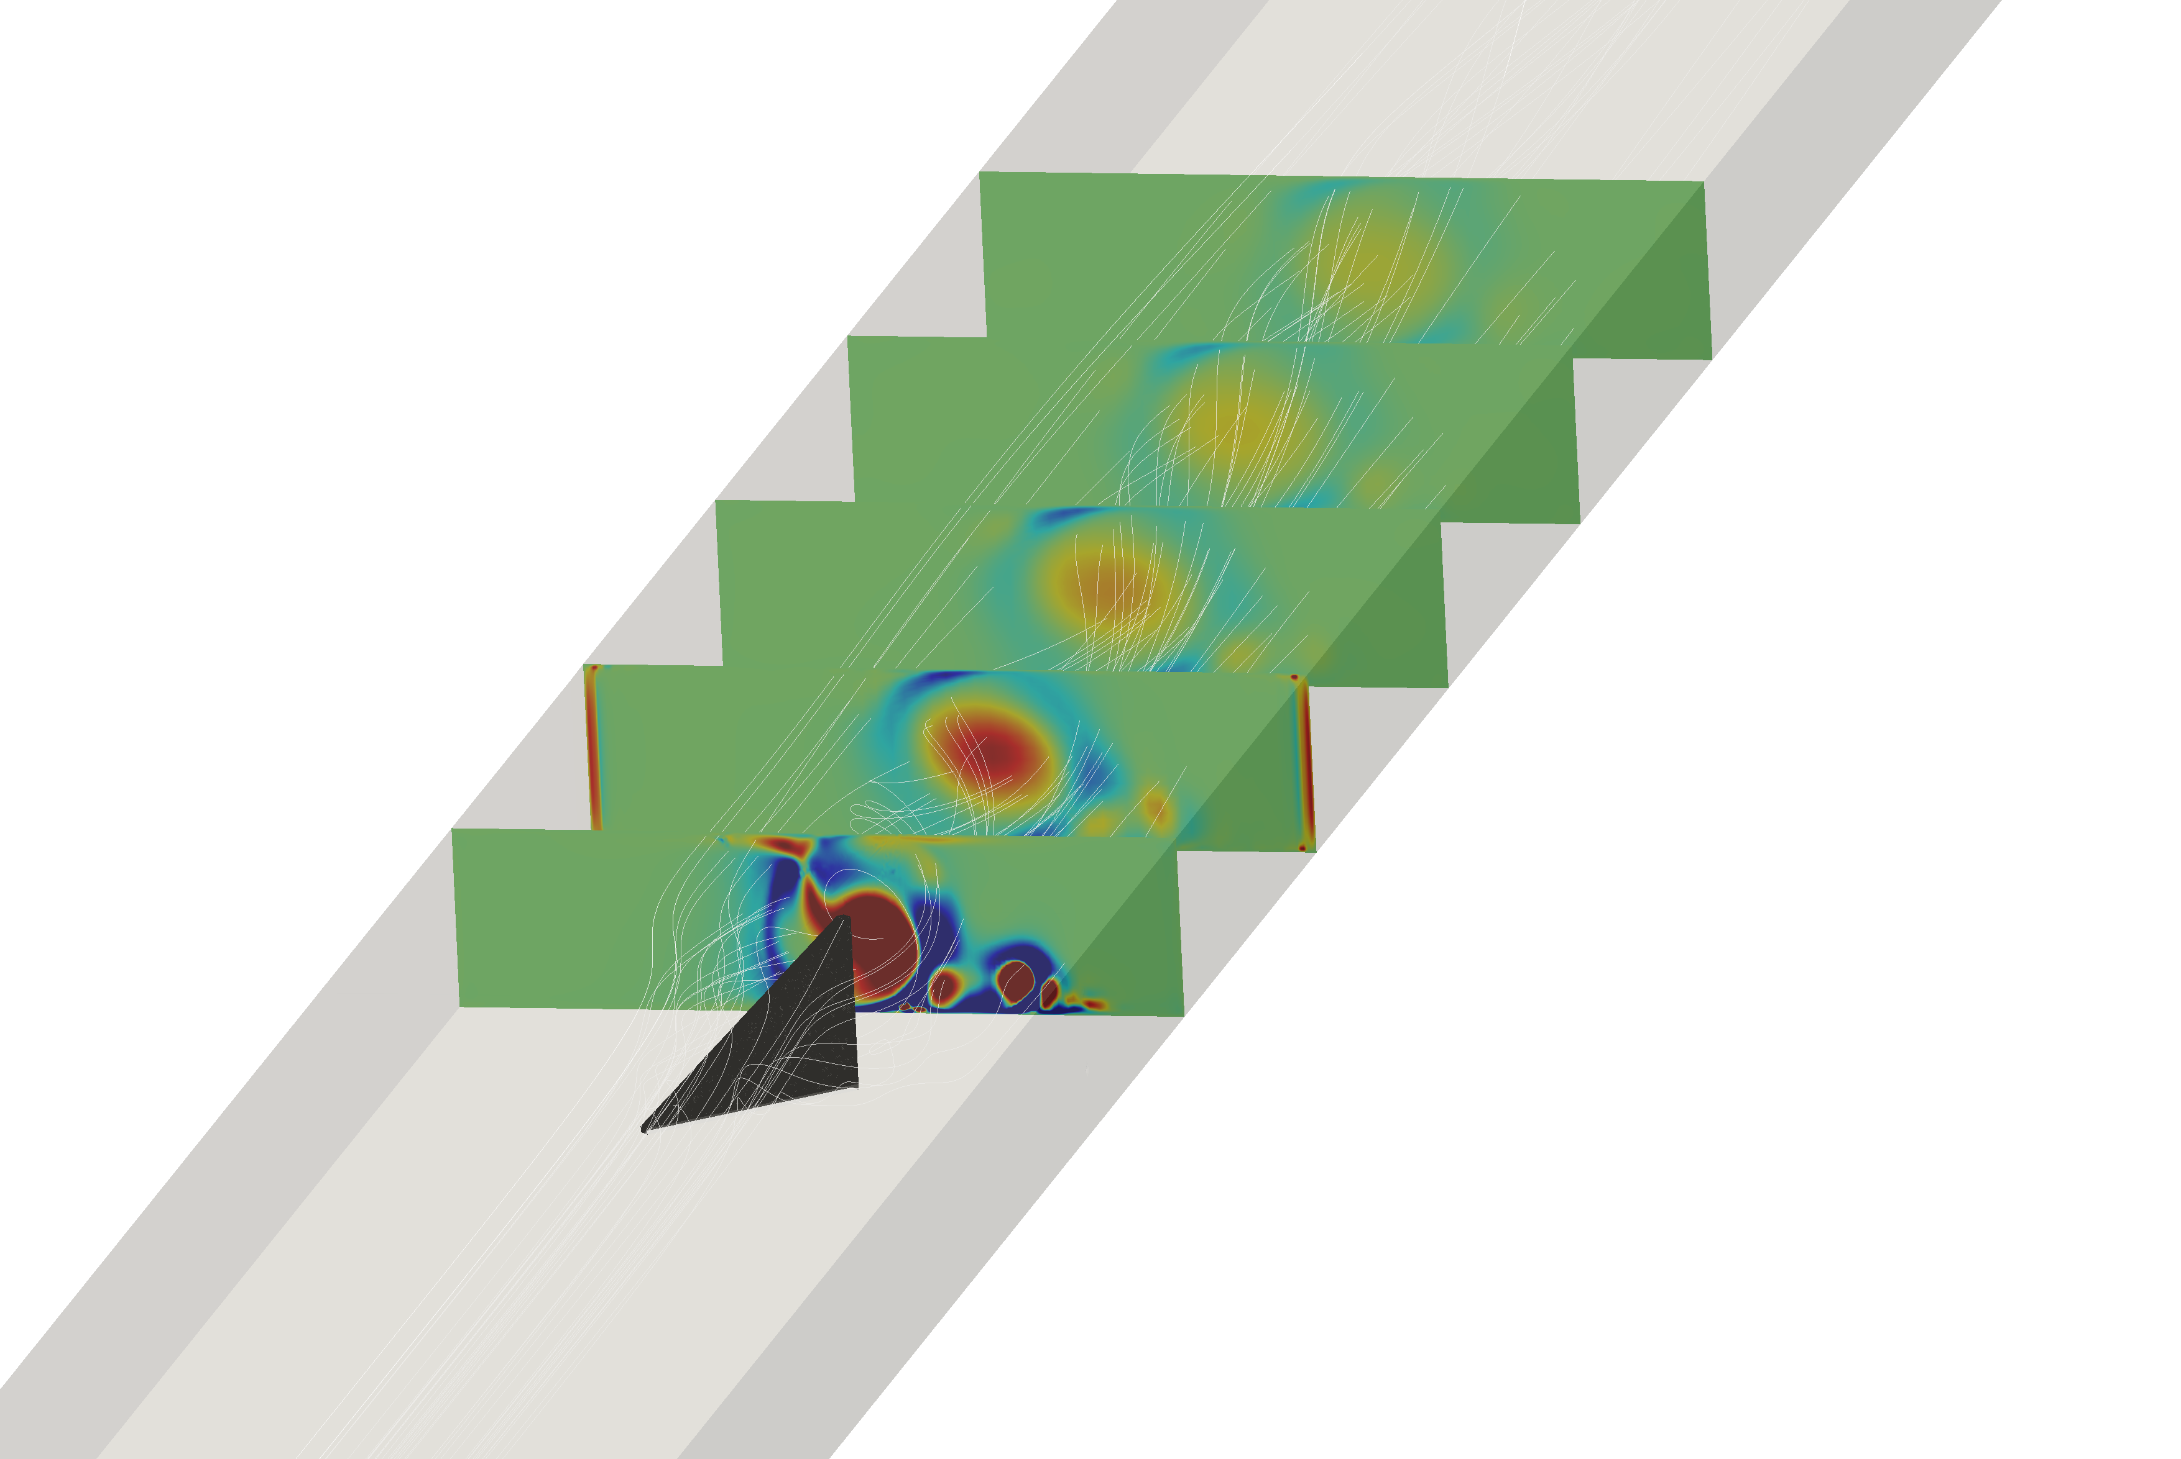
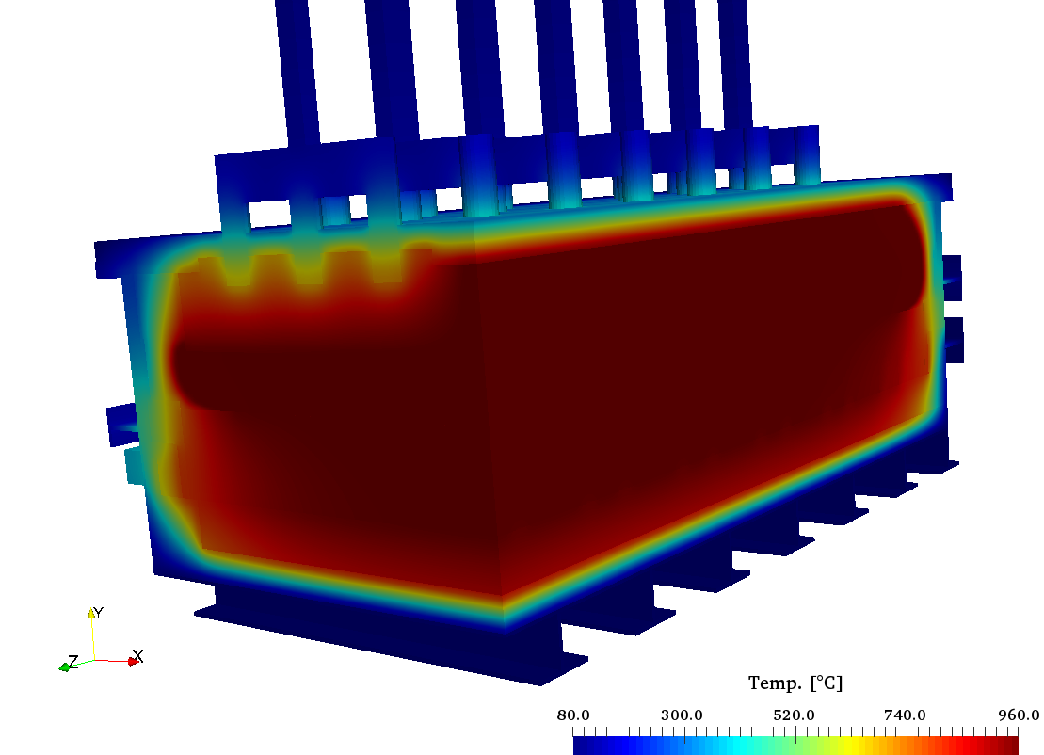
VirtualBatteryFoam: A multi-physics numerical solver to simulate aluminium electrolysis
Aluminium Electrolysis
Bubble dynamics
Magnetohydrodynamics
Turbulent heat transfer
Thermoelectric
VirtualBatteryFoam: A multi-physics tool
27.02.2019
Notes:
4 submodel -> 1 final model

Slide 7
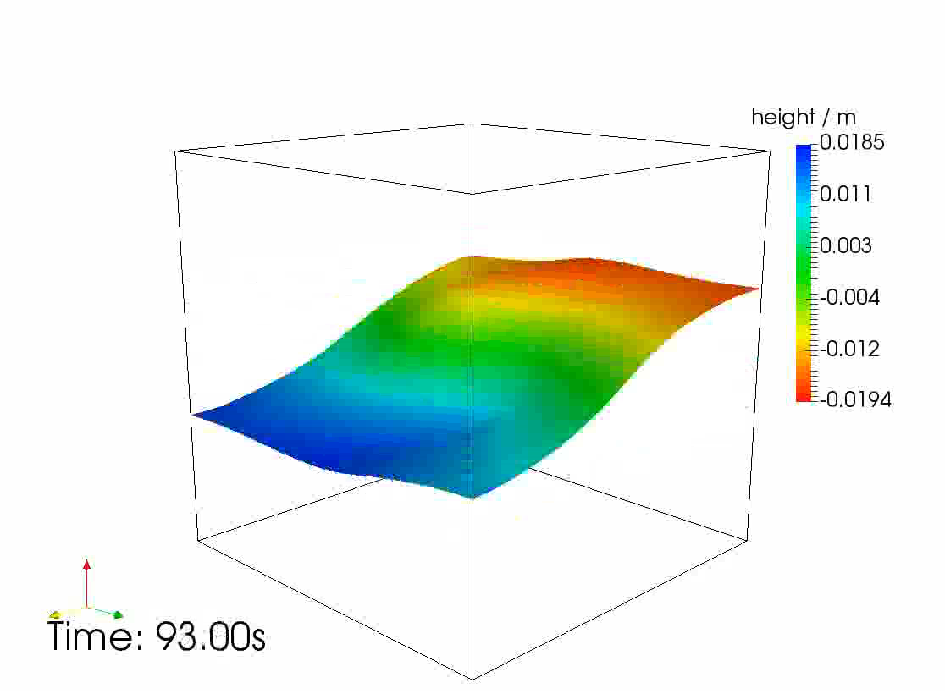
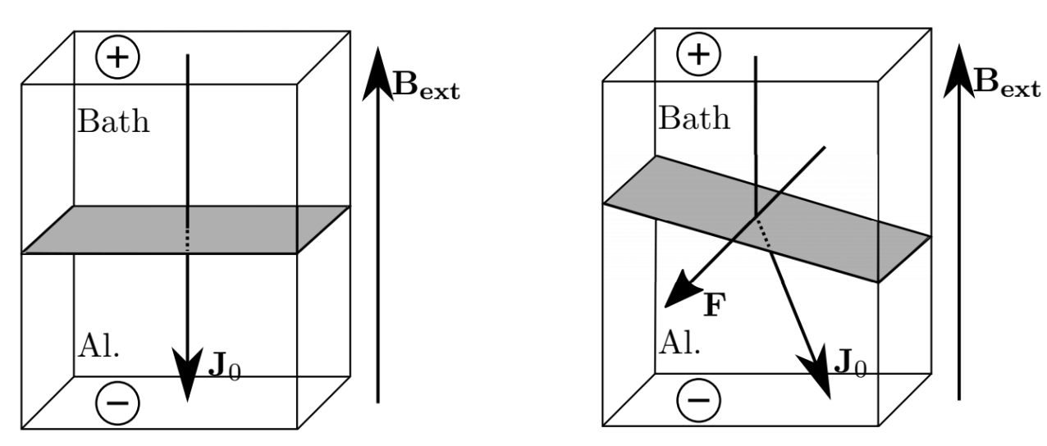
VirtualBatteryFoam: A multi-physics numerical solver to simulate aluminium electrolysis
Aluminium Electrolysis: Magnetohydrodynamics
Metal Pad Rolling
Current takes the least resistance path
Horizontal component of current reacts with vertical magnetic field to produce Lorentz force
The interface begins to rotate
27.02.2019

Slide 8
VirtualBatteryFoam: A multi-physics numerical solver to simulate aluminium electrolysis
Aluminium Electrolysis: Magnetohydrodynamics
Navier-Stokes
VoF
U,p,γ
Elec. Potential
$$∇∙\left(σ∇ϕ\right)=∇∙σ(u×B)$$
Elec. Potential
𝛻∙(𝜎𝛻ϕ)=𝛻∙𝜎(𝑢×𝐵)
Current density
$$J=σ\left(−∇ϕ+u×B\right)$$
Current density
𝐽=𝜎(−𝛻ϕ+𝑢×𝐵)
magn. potential
A(r)$=\frac{µ}{4π}\int_{V}{\frac{J\left(r^{′}\right)}{{\left|r−r^{′}\right|}^{}}dV\left(r^{′}\right) :∂Ω }$
$−∇^{2}A= μJ$ $:Ω$
magn. potential
A(r)=µ/4π ∫17_𝑉▒〖𝐽(𝑟^′ )/|𝑟−𝑟^′ |^ 𝑑𝑉(𝑟^′ ) :𝜕Ω 〗
−∇^2 𝐴= 𝜇𝐽 :Ω
Lorentz force
$$F_{L}=J×B$$
Lorentz force
𝐹_𝐿=𝐽×𝐵
magn. Field
$$B=∇×A$$
magn. Field
𝐵=∇×𝐴
27.02.2019

Slide 9
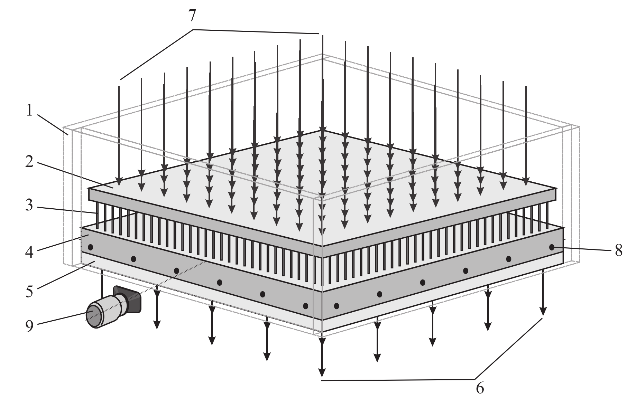
VirtualBatteryFoam: A multi-physics numerical solver to simulate aluminium electrolysis
Aluminium Electrolysis: Magnetohydrodynamics
Pedchenko Experiment
Pedchenko, S. Molokov, J. Priede, A. Lukyanov, and P. J. Thomas, Experimental model of the interfacial
instability in aluminium reduction cells," EPL (Europhysics Letters), vol. 88, p. 24001, Oct 2009.
1: Side walls, 2: Copper anode plate, 3: 900 Steel electrodes, 4: Liquid metal (InGaSn), 5: Steel cathode plate, 6 und 7: electrical connections
27.02.2019
Notes:
Immersed into liquid

Slide 10
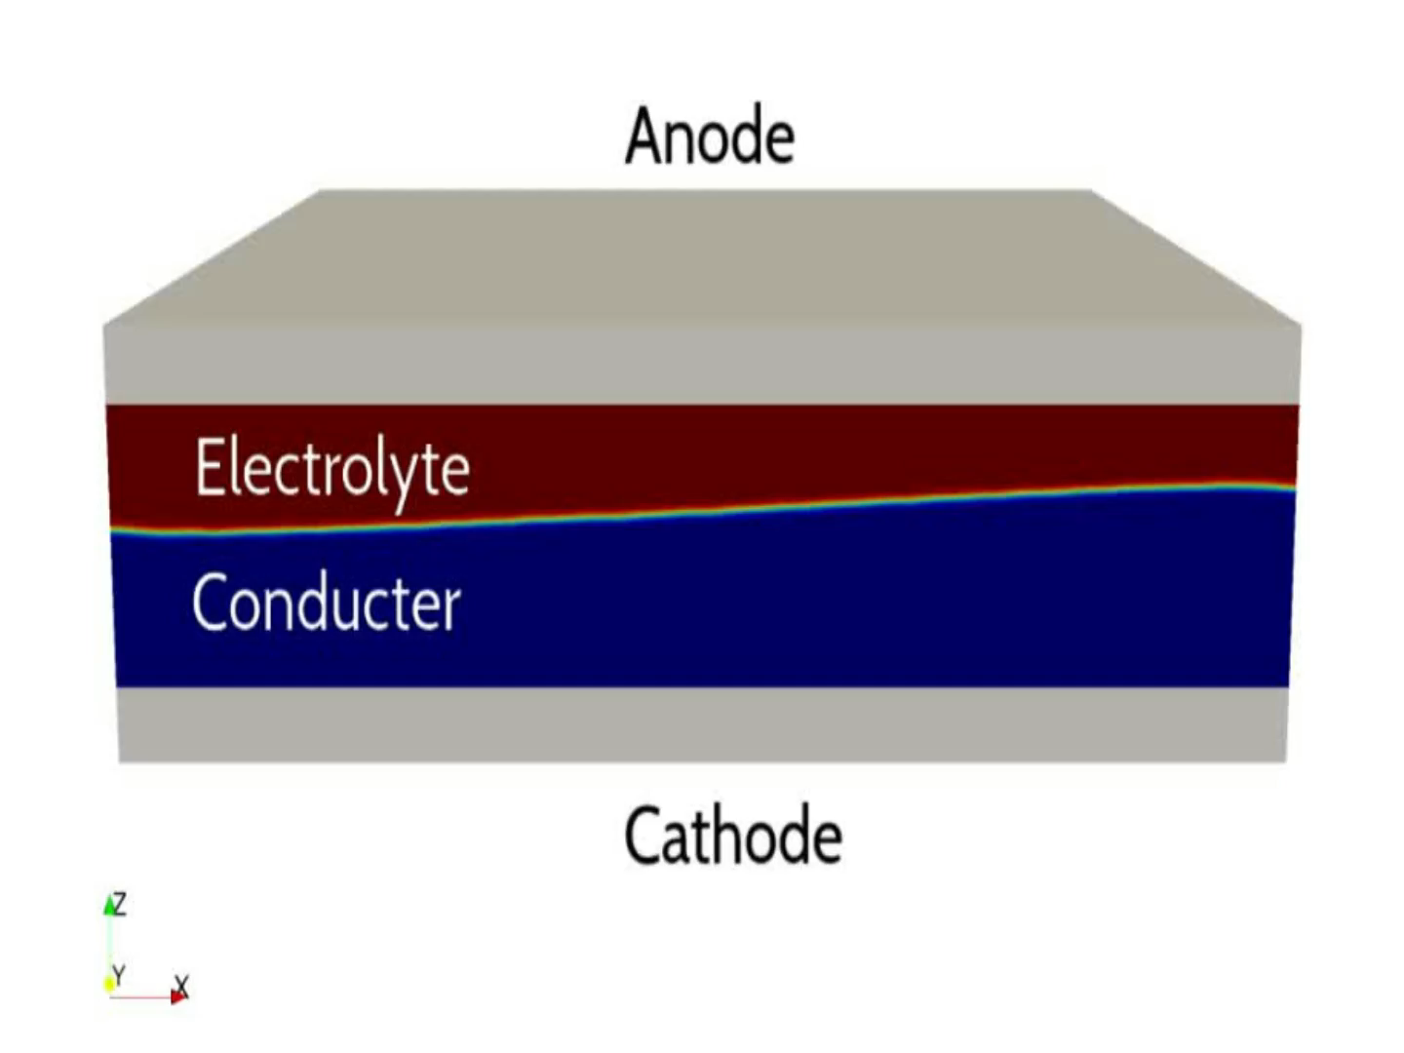
VirtualBatteryFoam: A multi-physics numerical solver to simulate aluminium electrolysis
Aluminium Electrolysis: Magnetohydrodynamics
27.02.2019

Slide 11
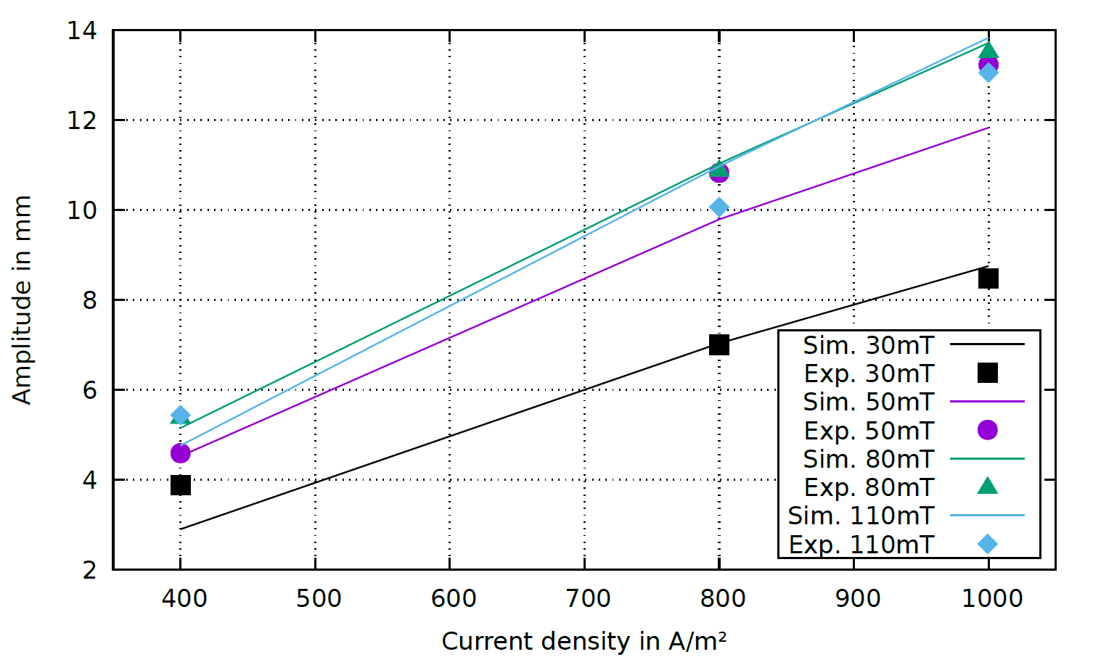
VirtualBatteryFoam: A multi-physics numerical solver to simulate aluminium electrolysis
Aluminium Electrolysis: Magnetohydrodynamics
27.02.2019

Slide 12
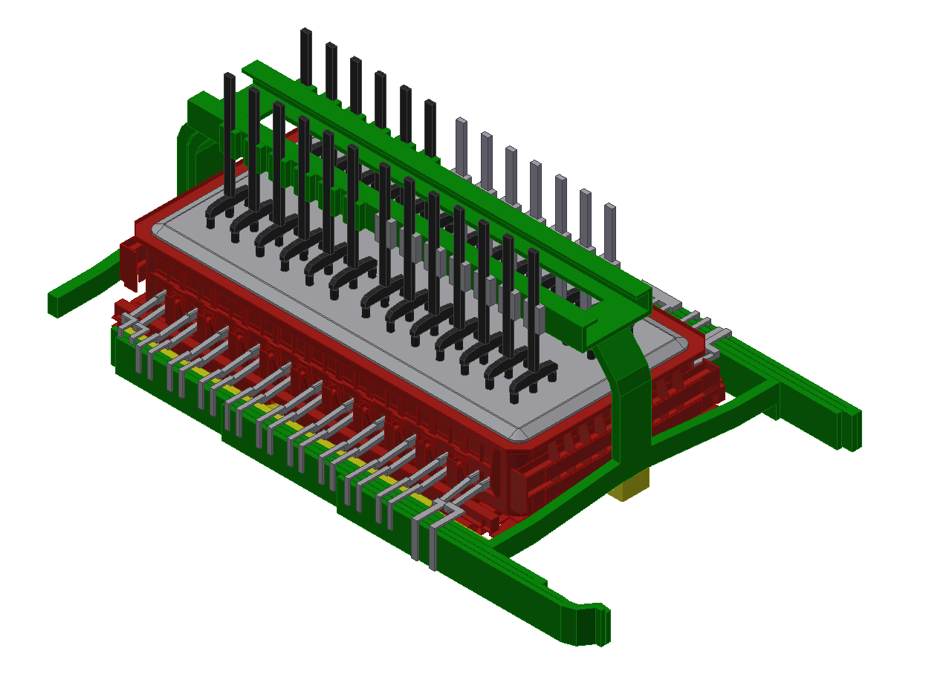
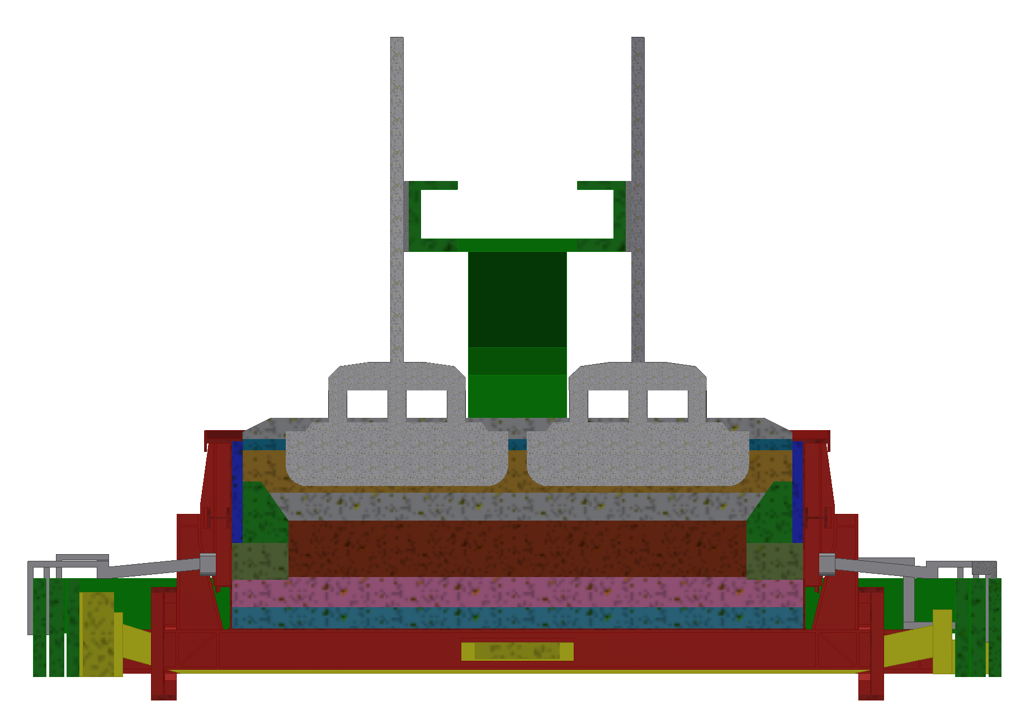
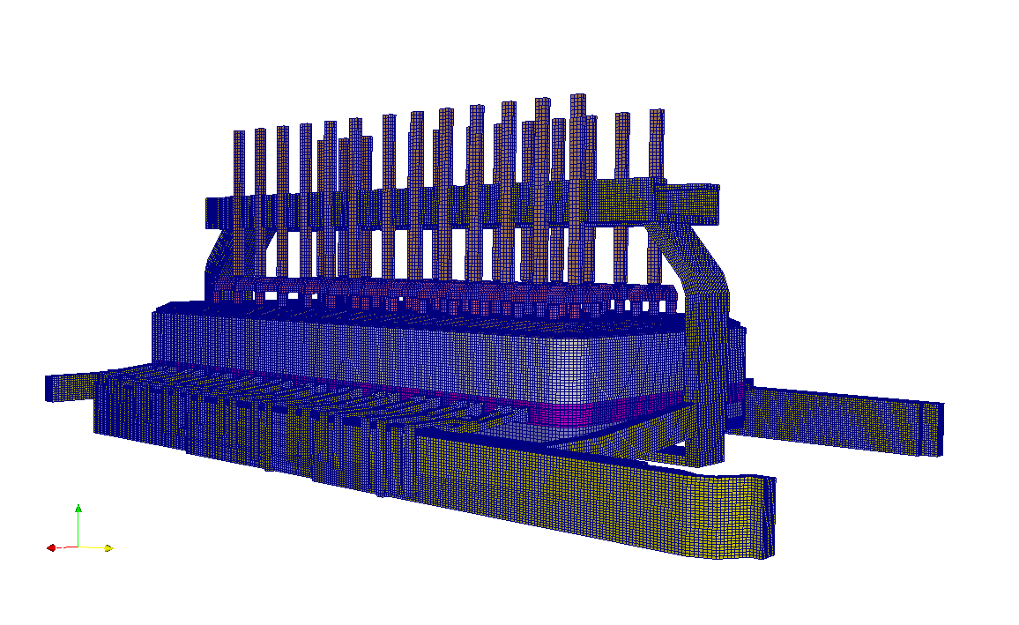
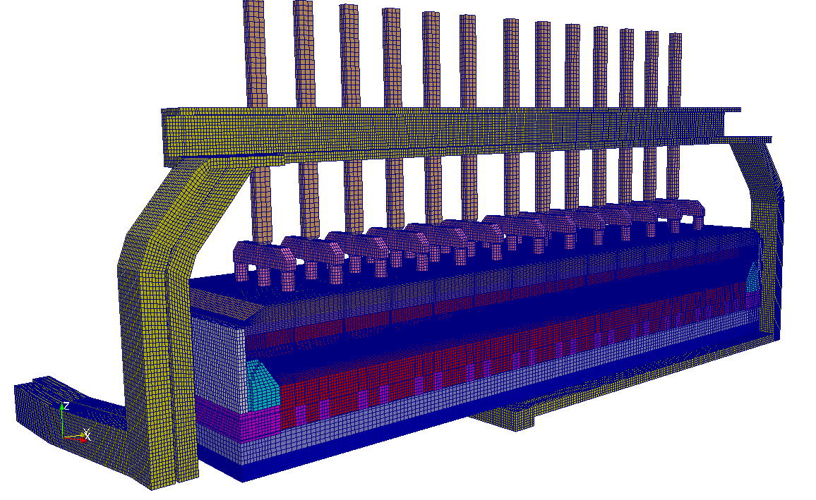
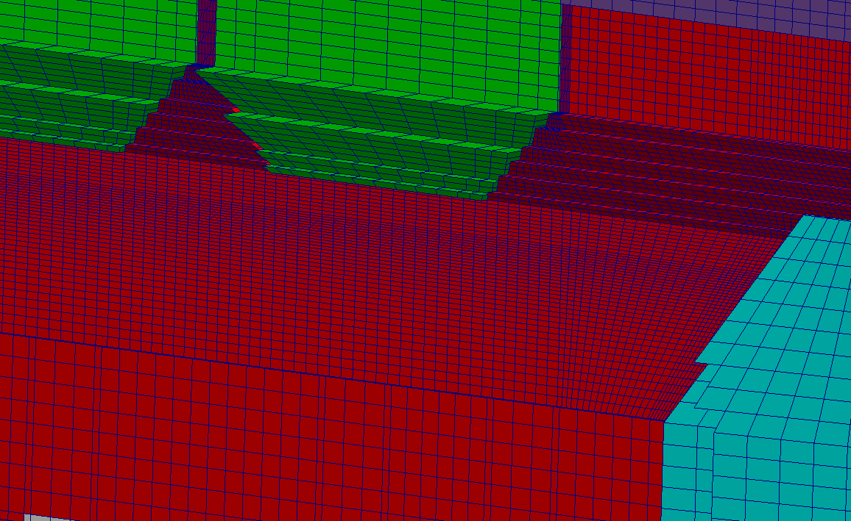
VirtualBatteryFoam: A multi-physics numerical solver to simulate aluminium electrolysis
Aluminium Electrolysis: Magnetohydrodynamics
Complete cell geometry
Structured mesh (10.000.000 Cells)
27.02.2019

Slide 13
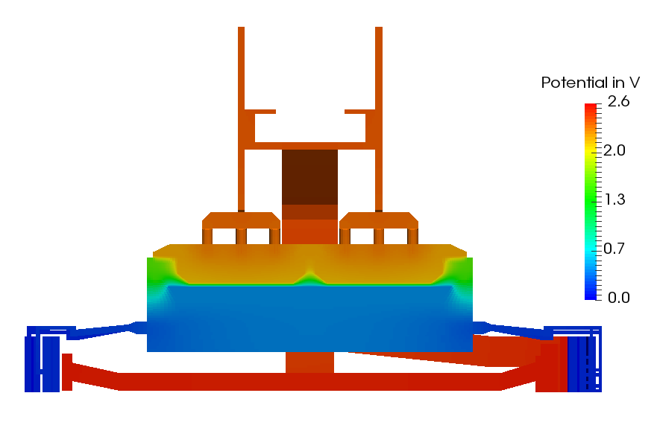
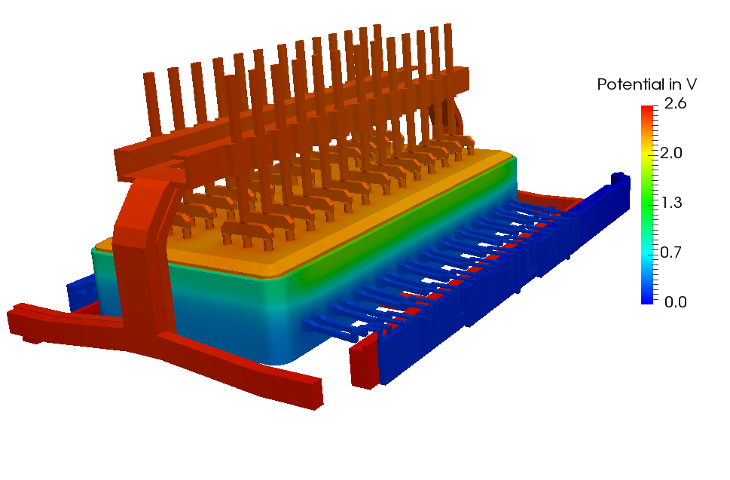
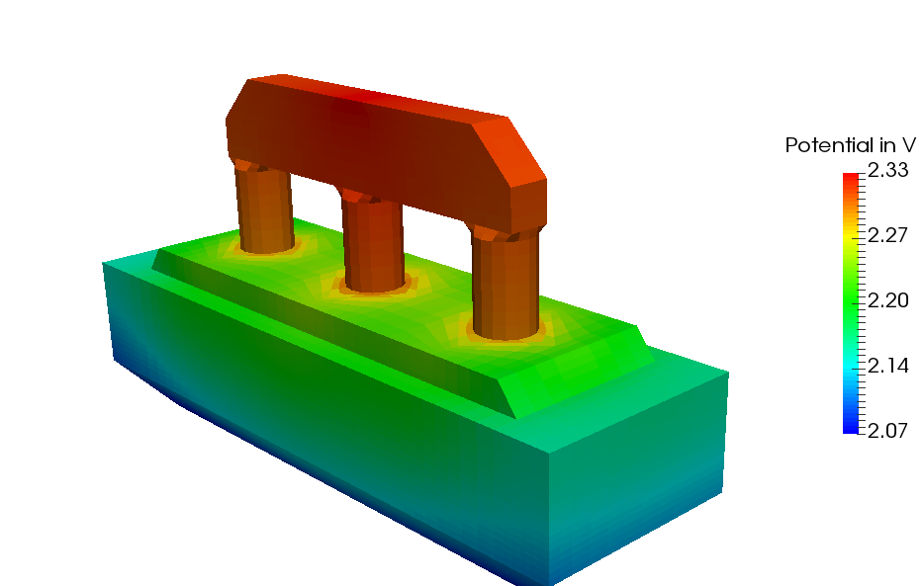
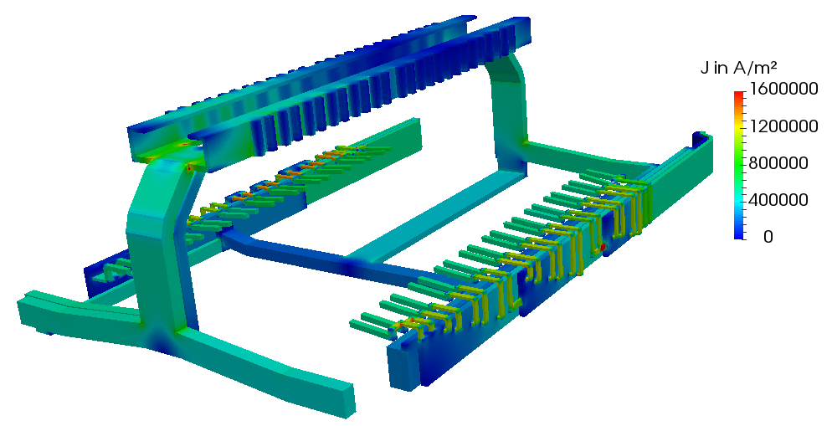
VirtualBatteryFoam: A multi-physics numerical solver to simulate aluminium electrolysis
Aluminium Electrolysis: Magnetohydrodynamics
Static electric field
27.02.2019
Notes:
14 Region

Slide 14
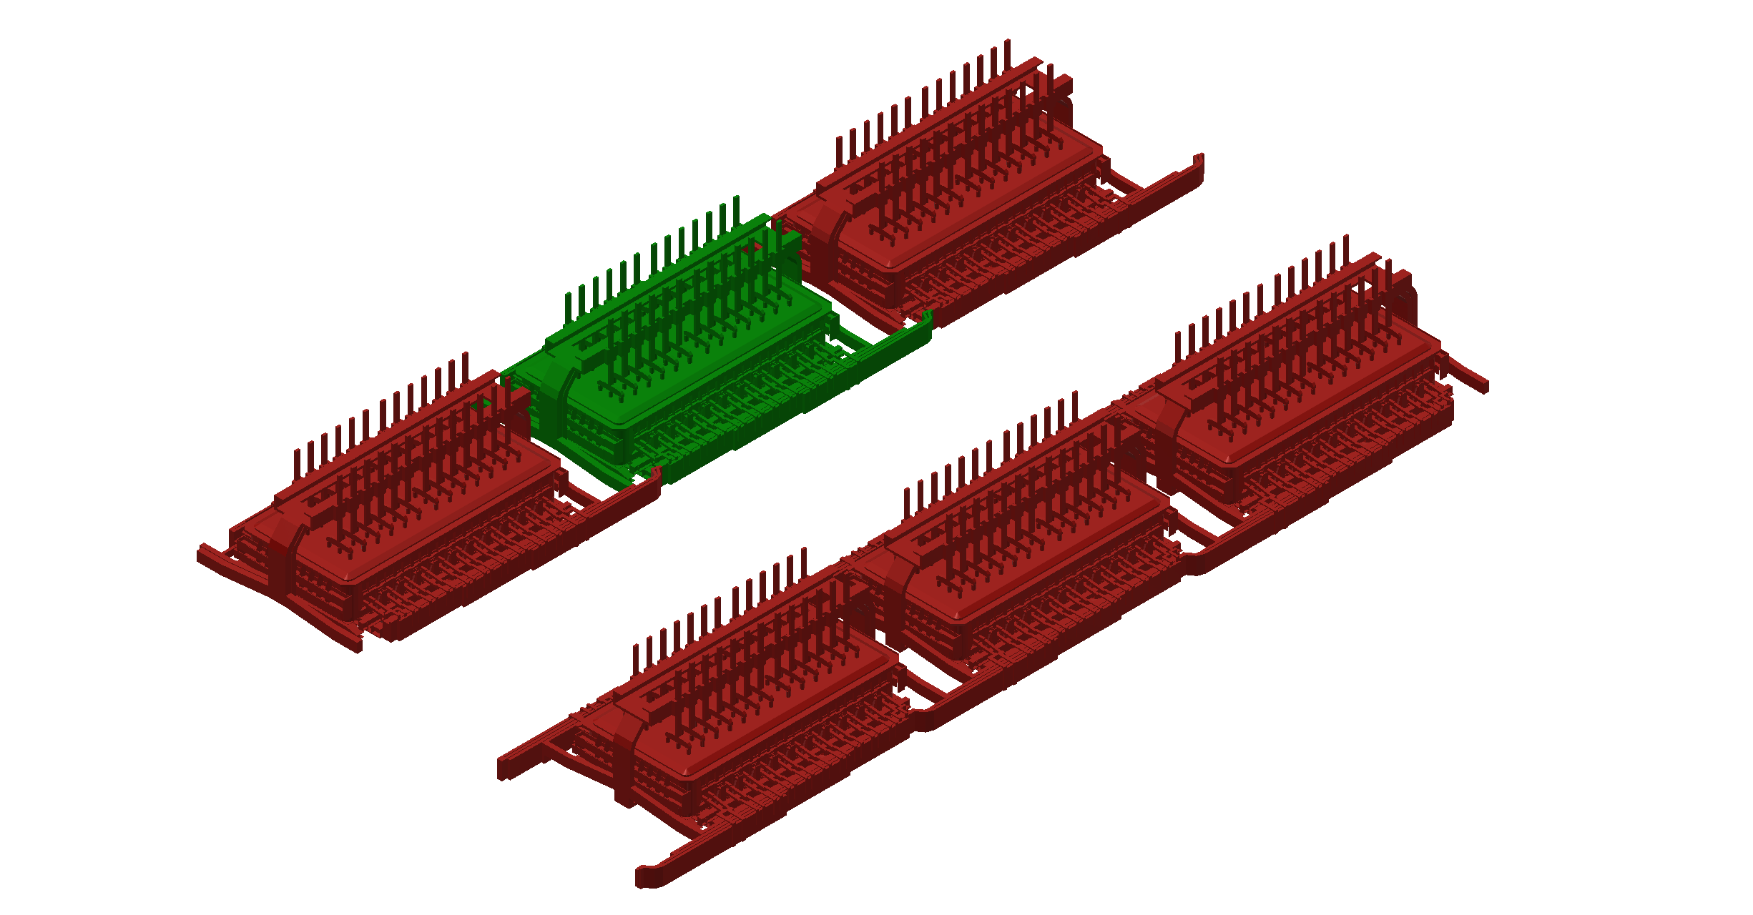
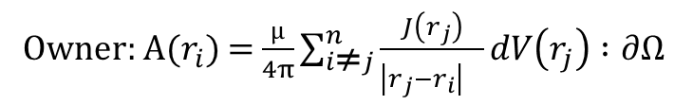
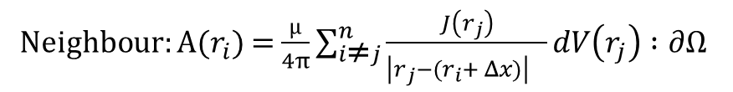
VirtualBatteryFoam: A multi-physics numerical solver to simulate aluminium electrolysis
Aluminium Electrolysis: Magnetohydrodynamics
Influence of magnetic field from the neighhbour cells
Owner: A($r_{i}$) = $\frac{µ}{4π}\sum_{i\text{≠}j}^{n}{\frac{J\left(r_{j}\right)}{{\left|r_{j}−r_{i}\right|}^{}}dV\left(r_{j}\right)} :∂Ω$
Neighbour: A($r_{i}$) = $\frac{µ}{4π}\sum_{i\text{≠}j}^{n}{\frac{J\left(r_{j}\right)}{{\left|r_{j}−{(r}_{i}+ Δx)\right|}^{}}dV\left(r_{j}\right)} :∂Ω$
27.02.2019

Slide 15
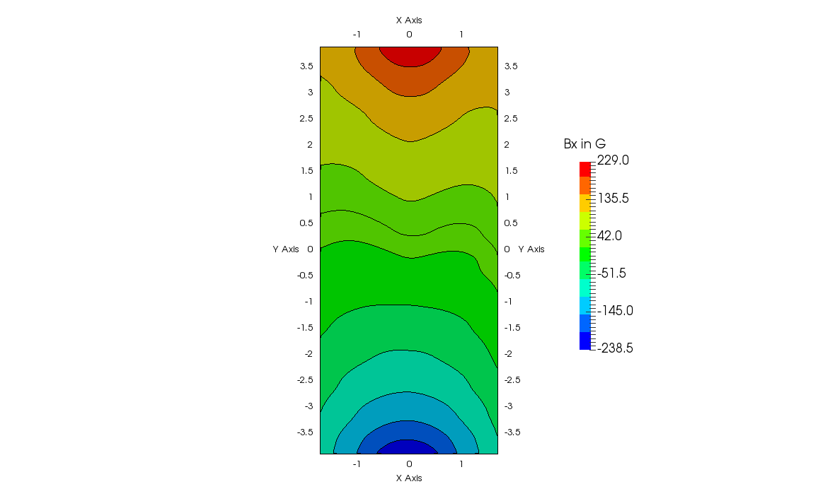
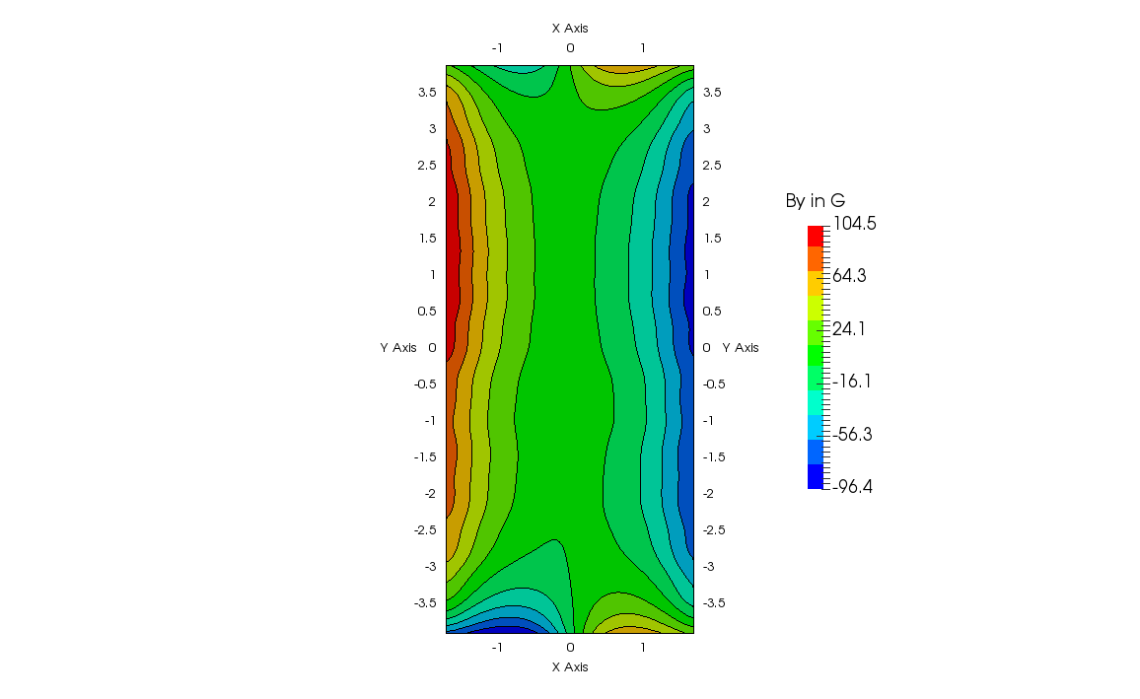
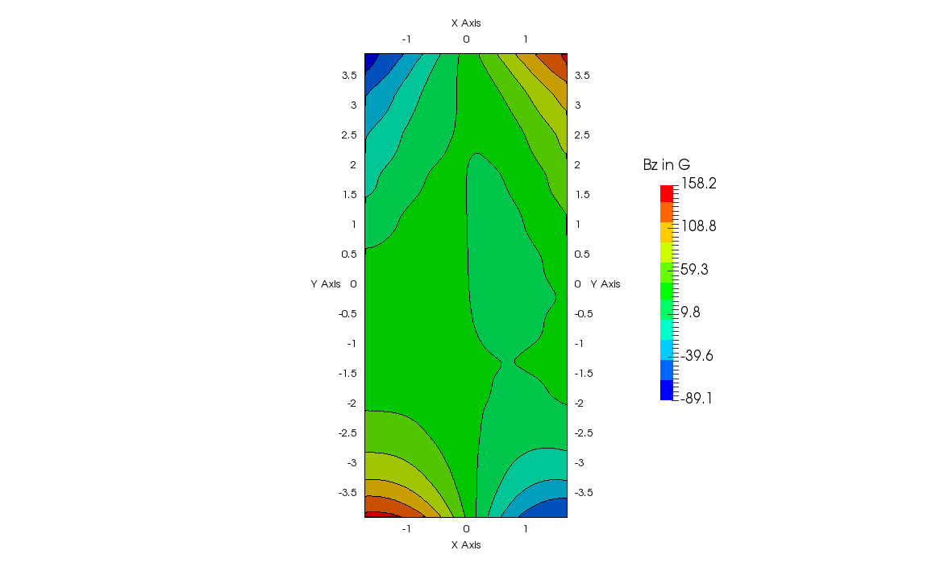
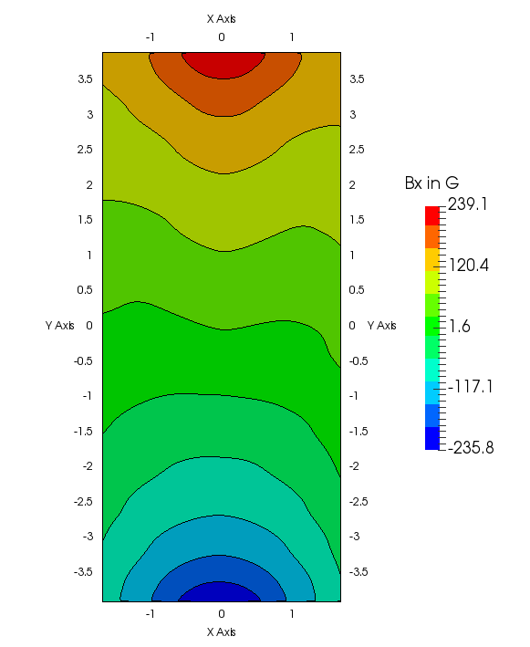
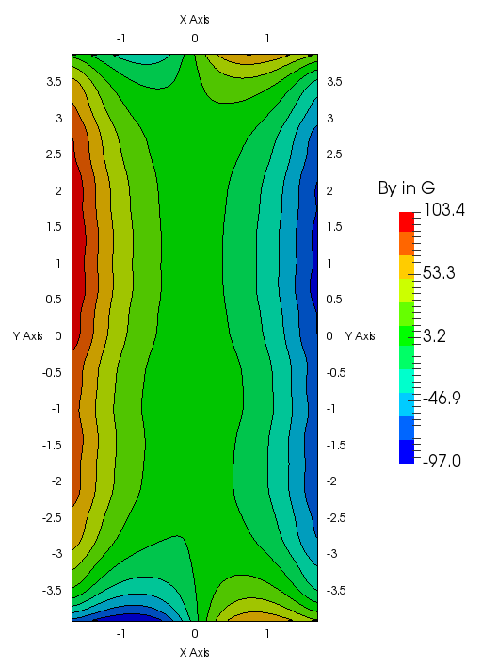
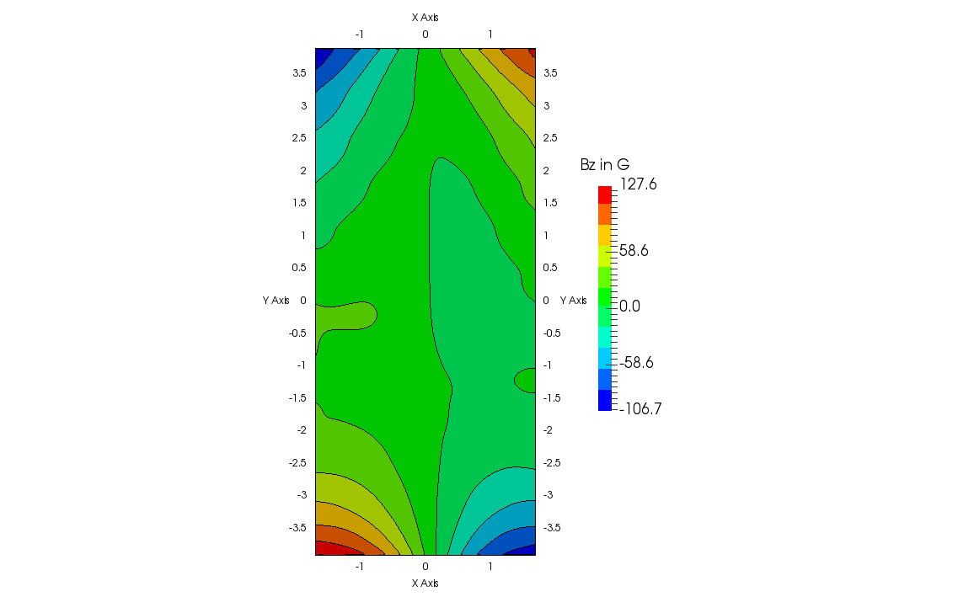
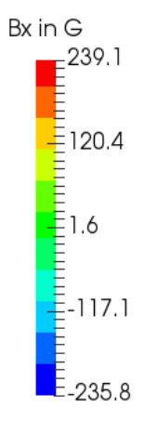
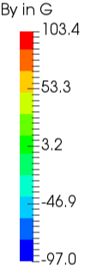
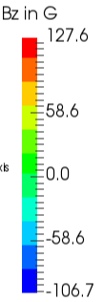
VirtualBatteryFoam: A multi-physics numerical solver to simulate aluminium electrolysis
Aluminium Electrolysis: Magnetohydrodynamics
Magnetic flux with and without the neighbour cells
X-component
Y-component
Z-component
without neighbour
upstream
with neighbour
27.02.2019

Slide 16
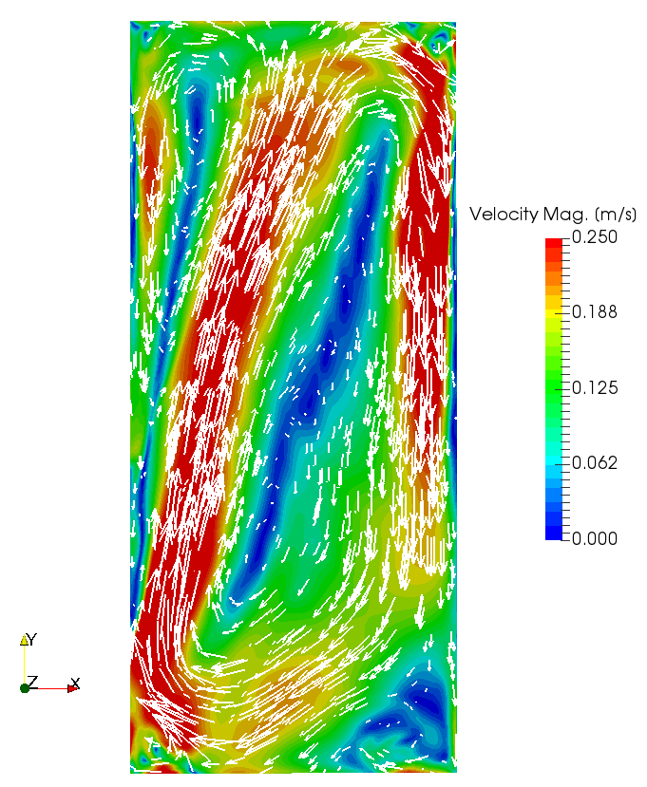
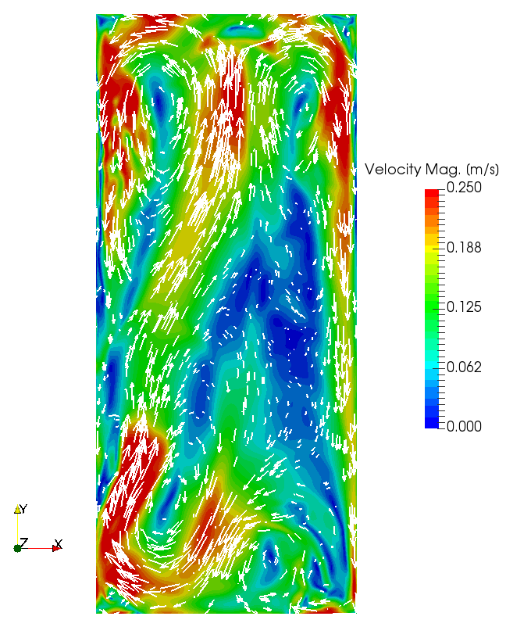
VirtualBatteryFoam: A multi-physics numerical solver to simulate aluminium electrolysis
Aluminium Electrolysis: Magnetohydrodynamics
Velocity field with and without the influence of neighbour cells
without neighbour
With neighbour
27.02.2019

Slide 17
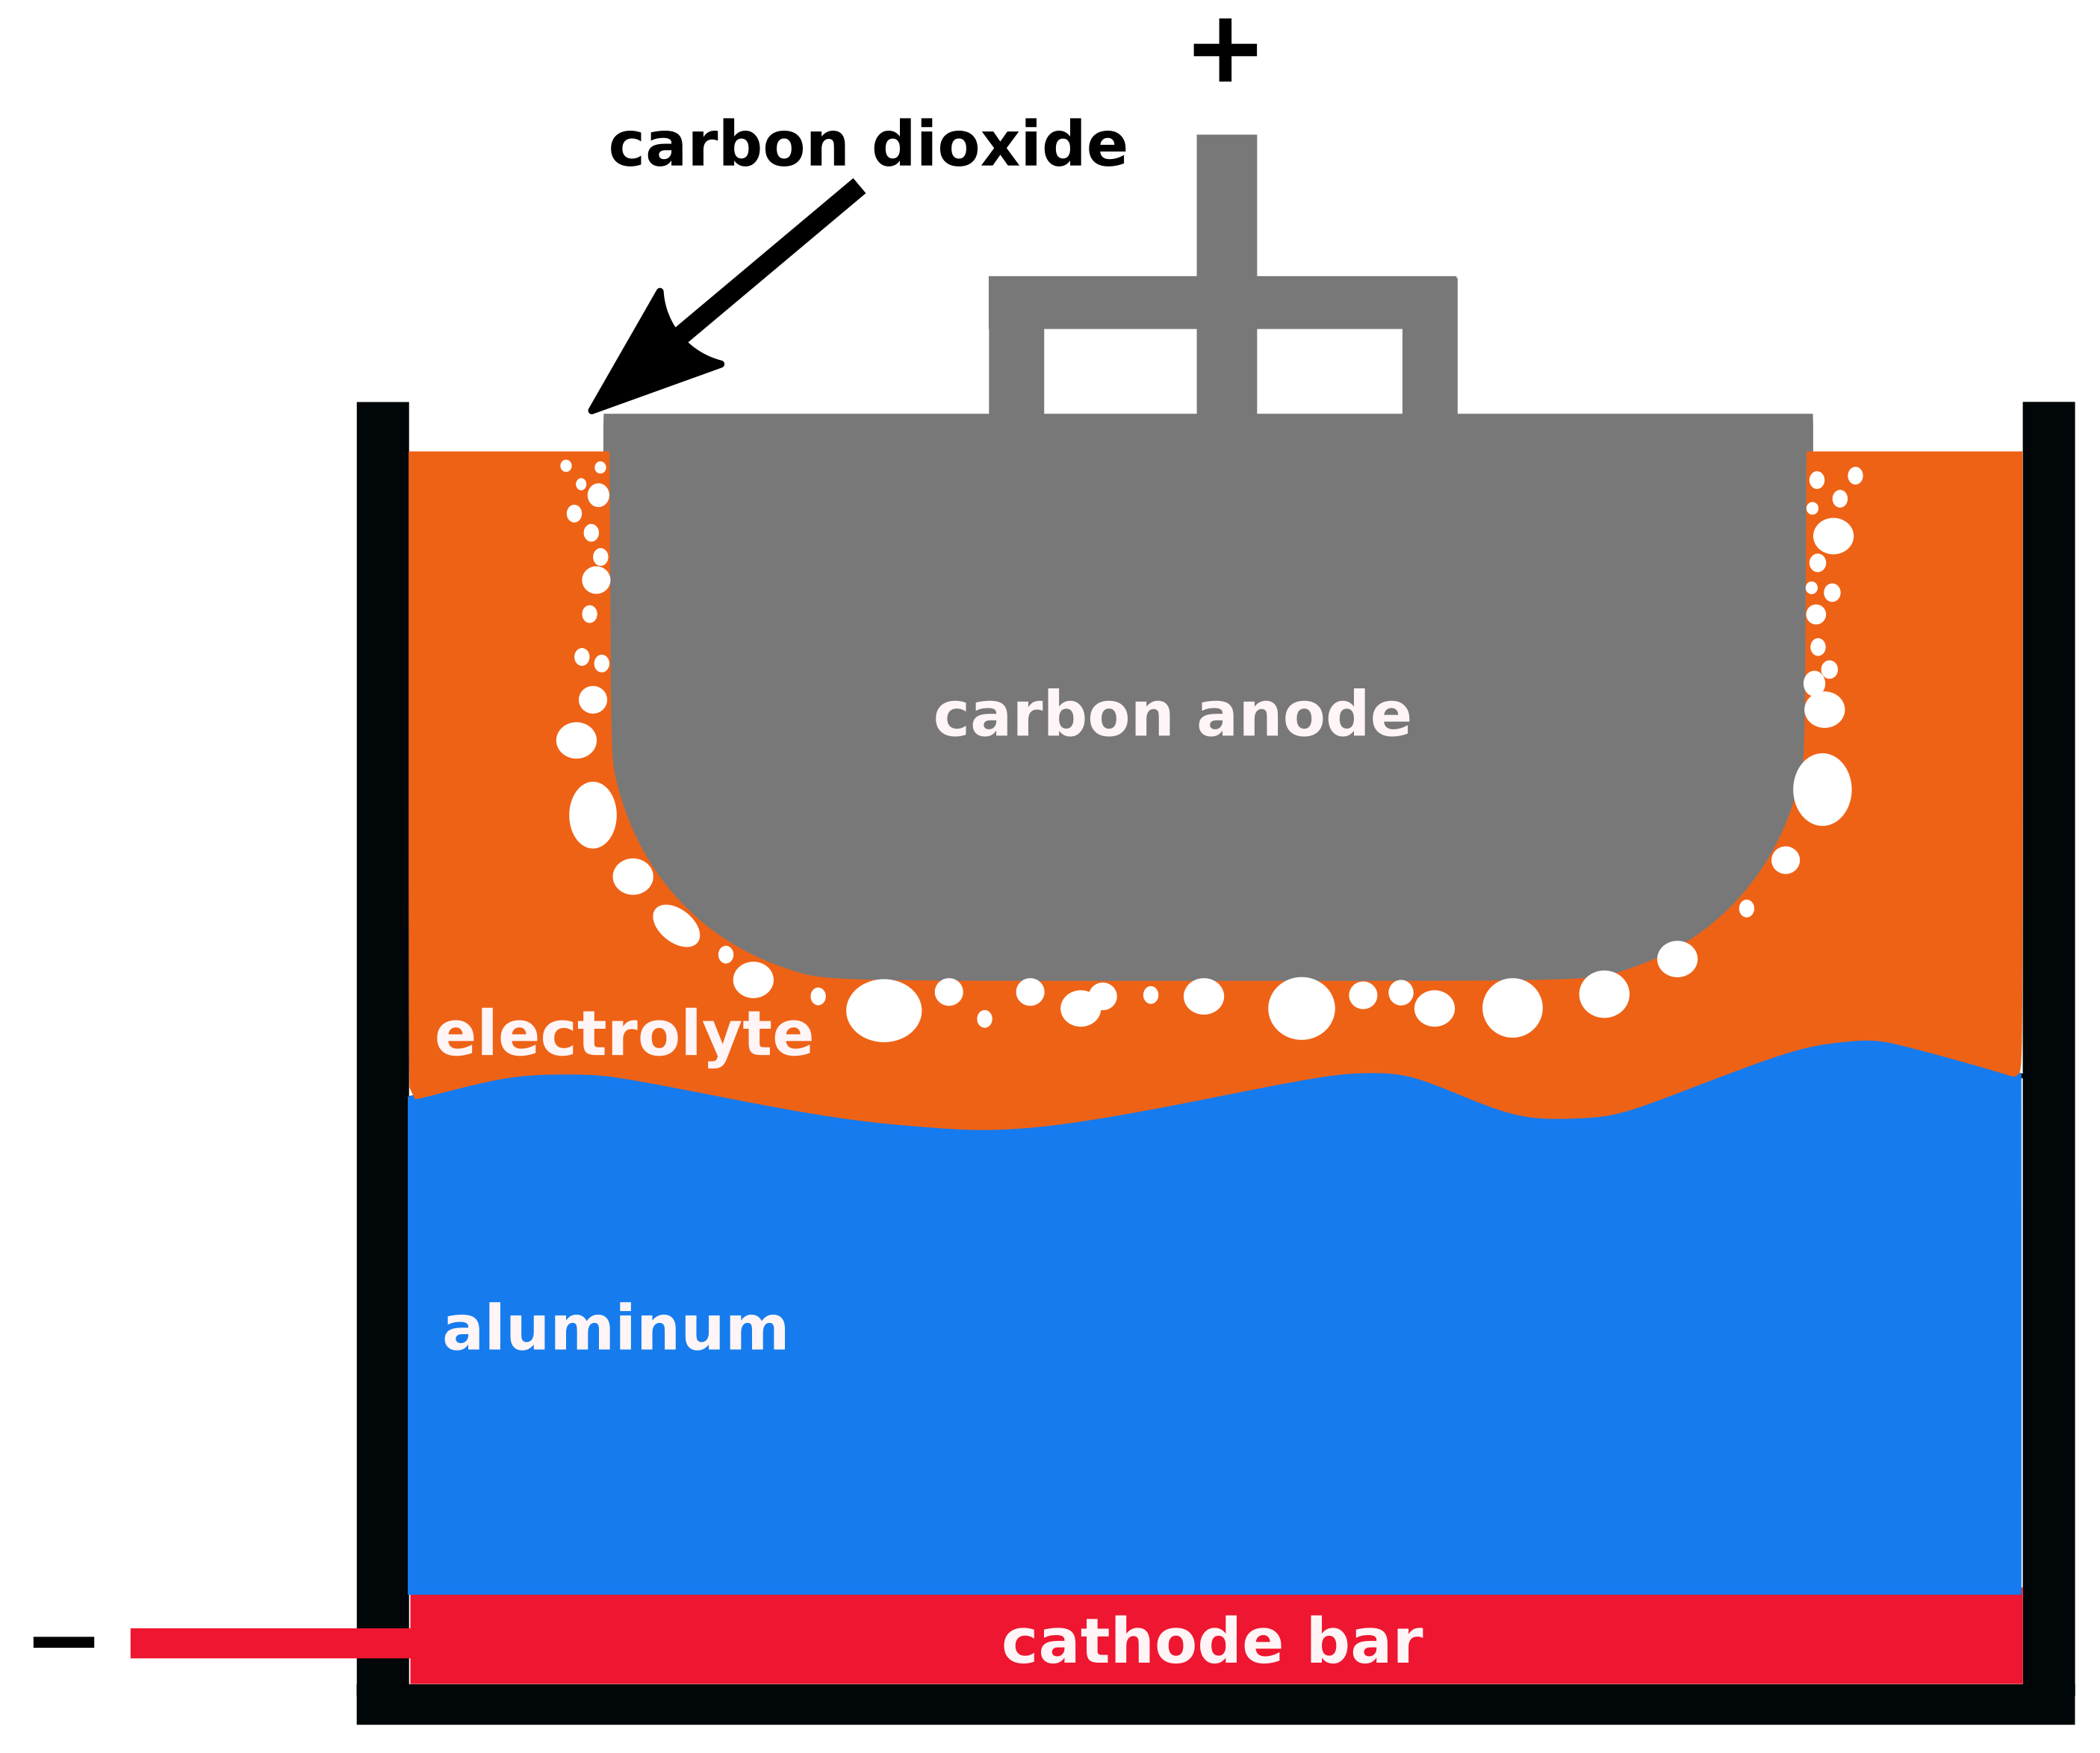
VirtualBatteryFoam: A multi-physics numerical solver to simulate aluminium electrolysis
Aluminium Electrolysis: mass transfer and bubble dynamics
During aluminum reduction process, gas (mainly CO₂) is produced at anode surfaces:
Gas production and gas dynamics disturb the interface electrolyte /aluminum
Gas layer under anodes introduces additional voltage drop
Target
Study gas production and gas dynamics
Optimize the cell geometry to reduce gas effects
27.02.2019
Notes:
CO2 low conductivity -> Voltage drop -> efficiency lost -> fast transport of CO2 out of system.
Study gasdynamics , Gas production

Slide 18
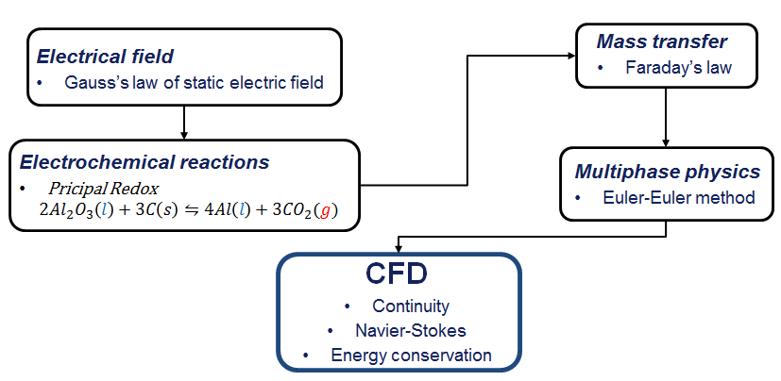
VirtualBatteryFoam: A multi-physics numerical solver to simulate aluminium electrolysis
Aluminium Electrolysis: mass transfer and bubble dynamics
Multiphase fluid dynamics problem involving:
electrochemical production of aluminum and gas
mass transfer and mass change (electrolyte → gas)
27.02.2019

Slide 19
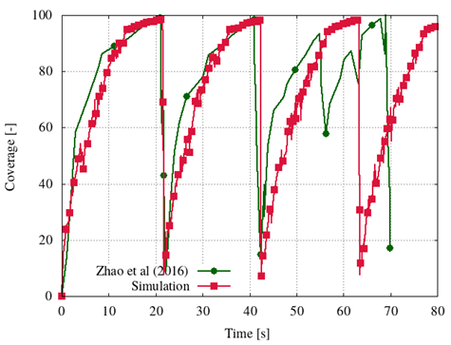
VirtualBatteryFoam: A multi-physics numerical solver to simulate aluminium electrolysis
Aluminium Electrolysis: mass transfer and bubble dynamics
 | Sim | Zhao et al.
Release frequency [s] | 21.5 | 21.5
Max coverage [%] | 97.8 | 98-99
Zhibin Zhao et al., Anodic bubble behavior and voltage drop in a laboratory transparent aluminum electrolytic cell, Met and Mat Trans B Vol 47, Issue 3, June 2016, 1962-1975
27.02.2019

Slide 20
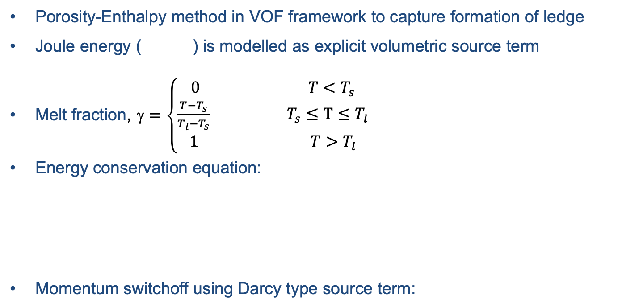
VirtualBatteryFoam: A multi-physics numerical solver to simulate aluminium electrolysis
Aluminium Electrolysis: Solidification (Ledge)
Porosity-Enthalpy method in VOF framework to capture formation of ledge
Joule energy ( ) is modelled as explicit volumetric source term
Melt fraction, $=\left\{\begin{aligned}0 T<T_{s} \\ \frac{T−T_{s}}{T_{l}−T_{s}} T_{s}≤T≤T_{l} \\ 1 T>T_{l}\end{aligned}\right.$
Energy conservation equation:
Momentum switchoff using Darcy type source term:
Solidification source
27.02.2019

Slide 21
VirtualBatteryFoam: A multi-physics numerical solver to simulate aluminium electrolysis
Aluminium Electrolysis: Solidification (Ledge)
Schematic
Experiment
Simulation
V. Nandana and U. Janoske, Experimental and numerical study on the melting behaviour of a phase change material in buoyancy driven flows, 7th European Conference on Computational Fluid Dynamics, Glasgow, 2018
27.02.2019

Slide 22
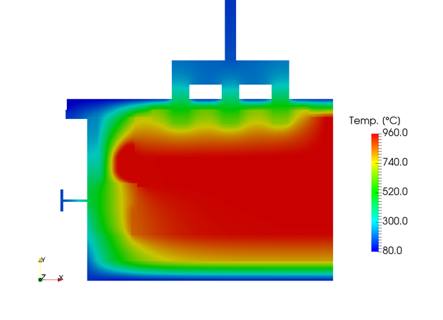
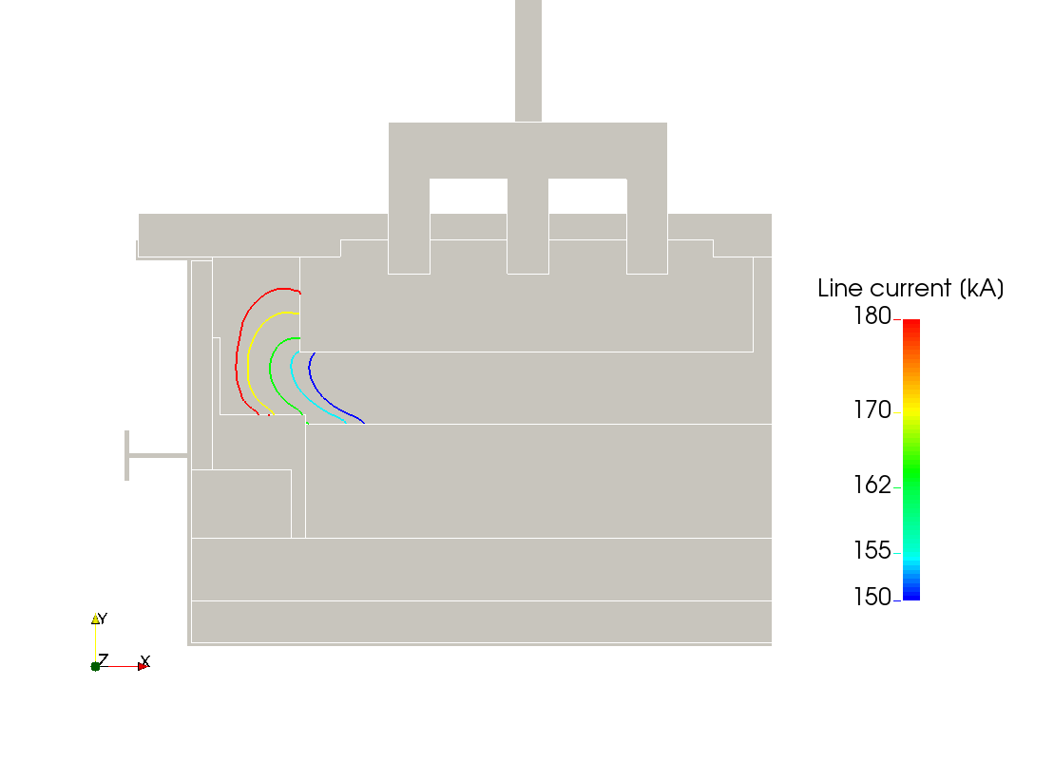
VirtualBatteryFoam: A multi-physics numerical solver to simulate aluminium electrolysis
Aluminium Electrolysis: Solidification (Ledge)
Temperature distribution
Ledge profile for different line currents
Thermal field and ledge profiles
27.02.2019

Slide 23
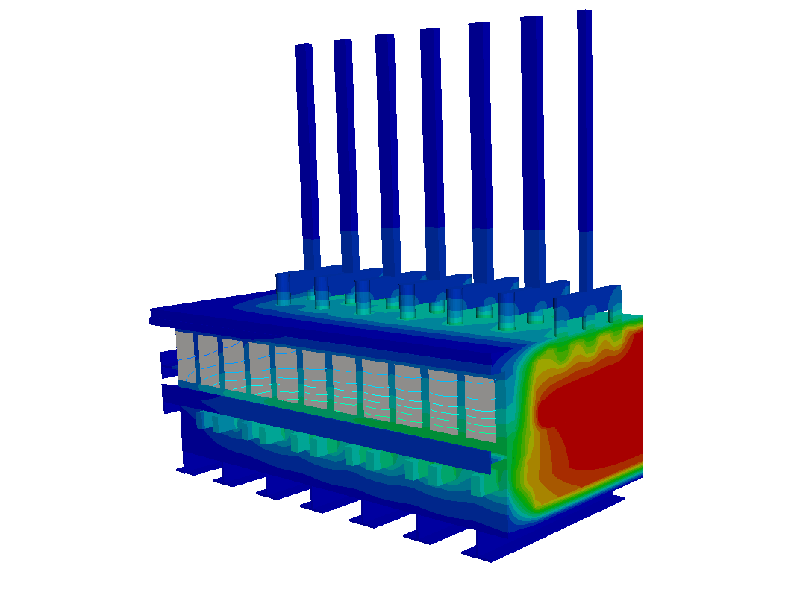
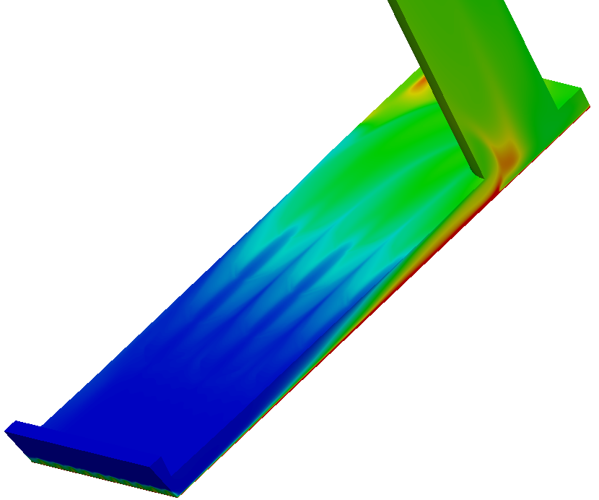
VirtualBatteryFoam: A multi-physics numerical solver to simulate aluminium electrolysis
Aluminium Electrolysis: Shell heat-exchanger
Approach to model reduction
Simulation of wall cooling with full resolved shell heat-exchangers not feasible
Reduction of SHE to wall heat flux boundary conditions
Temperature distribution in the cell
Temperature distribution in SHE
27.02.2019
Notes:
44 SHE -> seperated -> use as BC

Slide 24
VirtualBatteryFoam: A multi-physics numerical solver to simulate aluminium electrolysis
Heat transfer enhancement
Augmentation can be achieved by disrupting the boundary layer
Longitudinal vortices cause mixing and enhanced heat transfer
Passive methods to enhance heat transfer rates
  Winglets
27.02.2019
Notes:
Incease heat transport forced convection -> disrupting boundary layer -> enhanced heat transfer due to vortices -> Passive method -> winglet -> after winglet longitudinal vortice

Slide 25
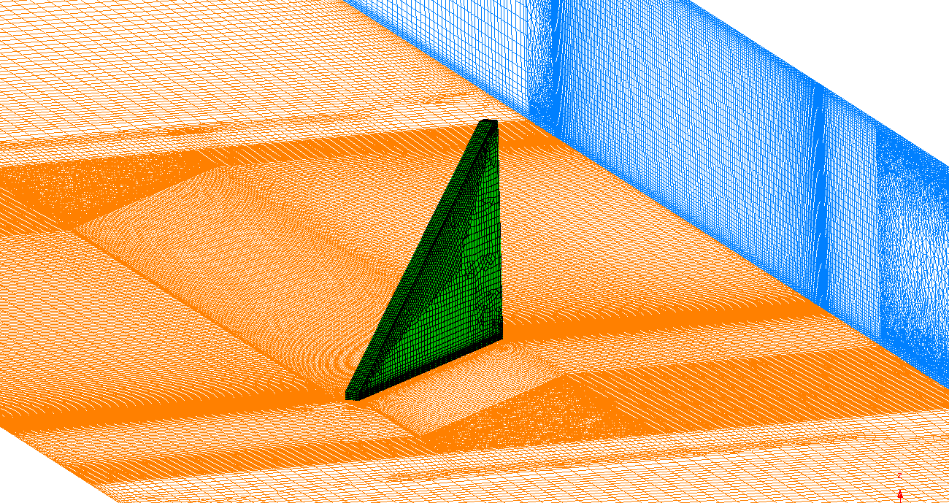

VirtualBatteryFoam: A multi-physics numerical solver to simulate aluminium electrolysis
Numerical approach for scientific studies
OpenFOAM® Version 4.0
Turbulence model RANS k-𝜔-SST
Divergence schemes second order
Solver rhoSimpleFoam
6.5 M cells (single) – 21 M cells (array)
Resolved wall boundary layer
  Max $y^{+}≈5$
  Average $y^{+}<1$
Mesh independency of results proved via three different mesh densities
  Semi-structured mesh of single delta winglet
27.02.2019
Notes:
Sience fine mesh , Industrial coarse mesh

Slide 26
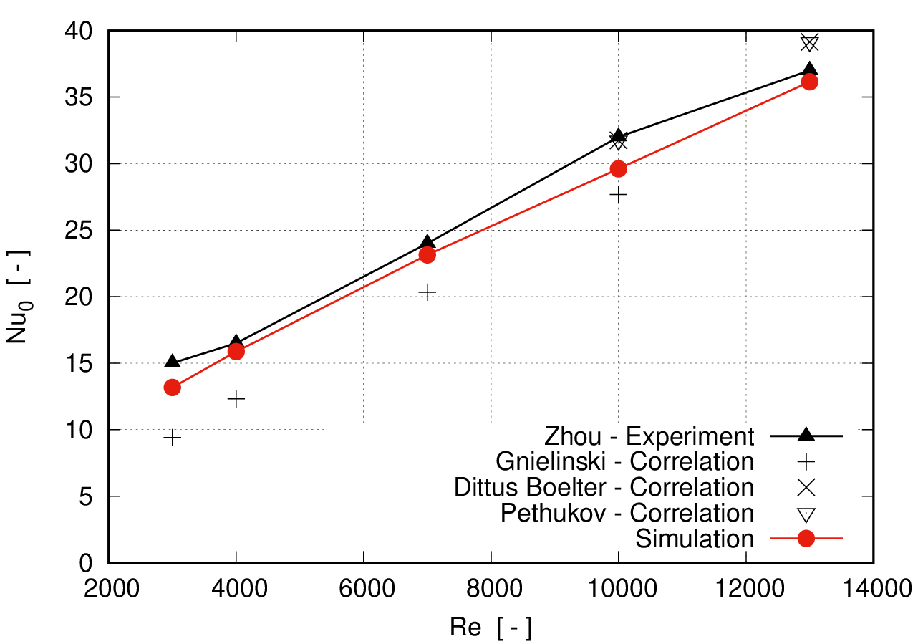



VirtualBatteryFoam: A multi-physics numerical solver to simulate aluminium electrolysis
Aluminium Electrolysis: Shell heat-exchanger
Smooth channel
  G. Zhou & Q. Ye, Experimental investigations of thermal and flow characteristics of curved trapezoidal winglet type vortex generators, Applied Thermal Engineering, Vol. 37, 2012
Channel with winglet
27.02.2019

Slide 27




VirtualBatteryFoam: A multi-physics numerical solver to simulate aluminium electrolysis
Aluminium Electrolysis: Shell heat-exchanger
Streamlines with temperature prolie
Qualitative distribution of surface heat flux at cell walls
27.02.2019
Notes:
Redirected 90° -> several winglets

Slide 28


VirtualBatteryFoam: A multi-physics numerical solver to simulate aluminium electrolysis
Aluminium Electrolysis: Shell heat-exchanger
Heat flux vs wall temperatures
$${\dot{V}}_{min}=0,0087 \frac{m^{3}}{s}⟹0\%$$
$${\dot{V}}_{max}=0,0272 \frac{m^{3}}{s}⟹100\%$$
27.02.2019
Notes:
Main take away easy to control -> linear -> good to control ledge thicknes

Slide 29
VirtualBatteryFoam: A multi-physics numerical solver to simulate aluminium electrolysis
Conclusions
Implementation of the numerical solver “VirtualBatteryFoam” presented.
The long wave instability is simulated and validated with experiments from Pedchenko et al.
The production of CO₂ and its dynamics comprising of coalescence, build-up and release is compared with the experimental results of Zhao et al. and was shown to be in good agreement.
The solidification model is validated with experimental results.
Fully resolved shell heat-exchanger simulations are carried out for model reduction of cell wall cooling
27.02.2019

Slide 30
VirtualBatteryFoam: A multi-physics numerical solver to simulate aluminium electrolysis
Future work
Implement a model for transport and dissolution of alumina
Couple heat transfer with solidification and MHD model
Extend the solver to include magnetisation effects of the steel shell
Validate the fully integrated model with industrial measurements.
27.02.2019

Slide 31
VirtualBatteryFoam: A multi-physics numerical solver to simulate aluminium electrolysis
Aluminium Electrolysis
Conferences
V. Nandana and U. Janoske, Experimental and numerical study on the melting behaviour of a phase change material in buoyancy driven flows, 7th European Conference on Computational Fluid Dynamics, Glasgow, 11-15 June 2018.
R. Gutt, V. Nandana, U. Janoske, A Numerical Study of Metal Pad Rolling Instability in a Simplified Hall-Héroult Cell, 7th European Conference on Computational Fluid Dynamics, Glasgow, 11-15 June 2018.
H. Gesell, V. Nandana, U. Janoske, Numerical investigation of the heat transfer characteristics of new winglet shapes in three-dimensional turbulent flows, 12th European Fluid Mechanics Conference, Vienna, Austria, 11th September 2018.
V. Nandana, R. Gutt, A. Cubeddu, R. Duessel, U. Janoske, A multi-physics numerical solver to simulate the aluminium electrolysis process, ICSOBA 2018, Belem, Brasil, 1st November 2018.
A. Cubeddu, V. Nandana, U. Janoske (2019). A numerical study of gas production and bubble dynamics in a Hall-Héroult reduction cell. Proceedings TMS 2019 Annual Meeting & Exhibition, San Antonio, Texas, USA.
Journal
V. Nandana, U. Janoske, Numerical study on the enhancement of heat transfer performance in a rectangular duct with new winglet shapes, Thermal Science and Engineering Progress 6 (2018) 95 – 103. doi:https://doi.org/10.1016/j.tsep.2018.03.005.
H. Gesell, V. Nandana, U. Janoske, Numerical study on the heat transfer performance and efficiency in a rectangular duct with new winglet shapes in turbulent flow, International Journal of Heat and Mass Transfer [in review].
27.02.2019

Slide 32
VirtualBatteryFoam: A multi-physics numerical solver to simulate aluminium electrolysis
Acknowledgements
This research was funded by the German Ministry of Education and Research under the project “SynErgie” (No. 03SFK3B1), whose support is gratefully acknowledged.
The authors would also like to thank the continuous support and cooperation of TRIMET Aluminium SE, Essen, Germany.
Additionally, the support of European Regional Development Fund (ERFE.NRW) and the state of Nordrhein-Westfalen through the projects “Aluminium Electrolysis 4.0” and “FlexTherm” is gratefully acknowledged.
The authors are grateful for the infrastructural support of the HPC cluster "Pleiades" at the University of Wuppertal.
27.02.2019

Slide 34


VirtualBatteryFoam: A multi-physics numerical solver to simulate aluminium electrolysis
Aluminium Electrolysis: mass transfer and bubble dynamics
Mass transfer → Faraday’s law
$\dot{m}=\frac{I M}{1000 F z}$ [kg/s]
where
I – current passing through electrode (kA)
M – molar mass of the substance (g/mol)
F – Faraday constant (C/mol)
Z – valency number
Electric current → Gauss`s law
$∇^{2}(σΦ)$=0
Where
$σ$ is the electrical conductivity (S/m) and
$Φ$ is the potential drop (V)
27.02.2019

Slide 35

VirtualBatteryFoam: A multi-physics numerical solver to simulate aluminium electrolysis
Aluminium Electrolysis: mass transfer and bubble dynamics
27.02.2019

Slide 36


VirtualBatteryFoam: A multi-physics numerical solver to simulate aluminium electrolysis
Aluminium Electrolysis: mass transfer and bubble dynamics
Multiphase fluid dynamics → Euler-Euler method
  Aluminium and bath as continuous phase
  Gases as dispersed phase
  Each phase has its own mass and momentum conservation equation
Momentum equation
$\frac{∂}{∂t}\left(ρ_{φ}α_{φ}u_{φ}\right)+∇∙\left(ρ_{φ}α_{φ}u_{φ}u_{φ}\right)=−$ $∇p+∇∙τ_{φ}+{{\dot{m}}_{φφ}u}_{φ}+M_{φφ}$
Volume Fraction conservation
$$\frac{∂}{∂t}\left(ρ_{φ}α_{φ}\right)+∇∙\left(ρ_{φ}α_{φ}u_{φ}\right)={\dot{m}}_{φφ}$$
Where
$φφ$ indicates a pair of phases (e.g. electrolyte/gas)
$M_{φ}$ represents the interface forces between phases (like: lift, drag, virtual mass, wall lubrication, etc.)
where $M_{k}$ is sum of drag, lift and virtual mass forces
27.02.2019

